Slide 1
In the Beginning God created the heavens and the earth.

Slide 2
“Then God said, ‘Let us make man in our image, in our likeness, and let them rule over the fish of the sea and the birds of the air, over the livestock, over all the earth, and over all the creatures that move along the ground.’" Genesis 1:26

Slide 3
“The LORD God formed the man from the dust of the ground and breathed into his nostrils the breath of life, and the man became a living being.”
Genesis 2:7

Slide 4
Hebrews 11:3- 3 By faith we understand that the worlds were prepared by the word of God, so that what is seen was not made out of things which are visible.

Slide 5
Romans 4:17 -…even God, who gives life to the dead and calls into being that which does not exist.

Slide 6
John 1:1-3 - 1 In the beginning was the Word, and the Word was with God, and the Word was God. 2 He was in the beginning with God. 3 All things came into being through Him, and apart from Him nothing came into being that has come into being.
NASU

Slide 7
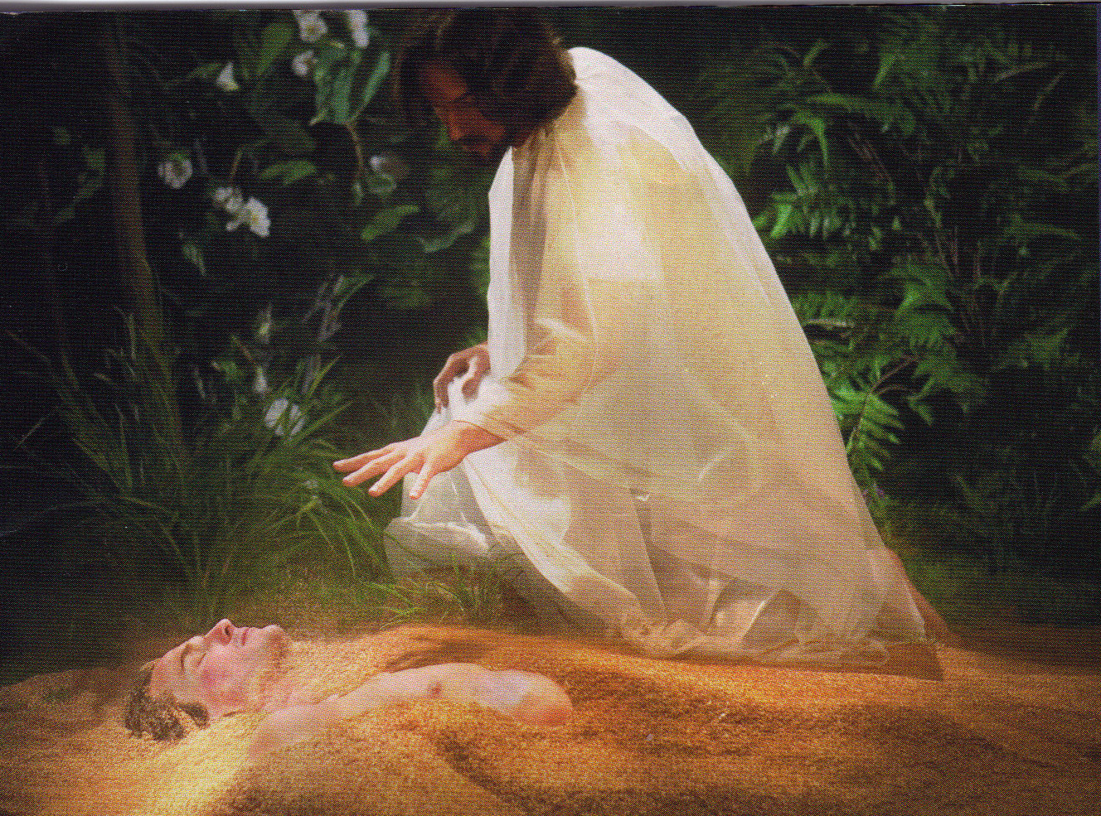

Slide 8
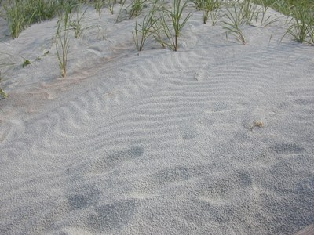

Slide 9
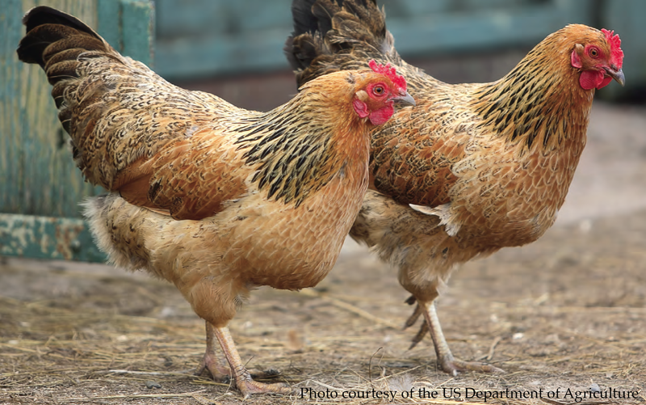
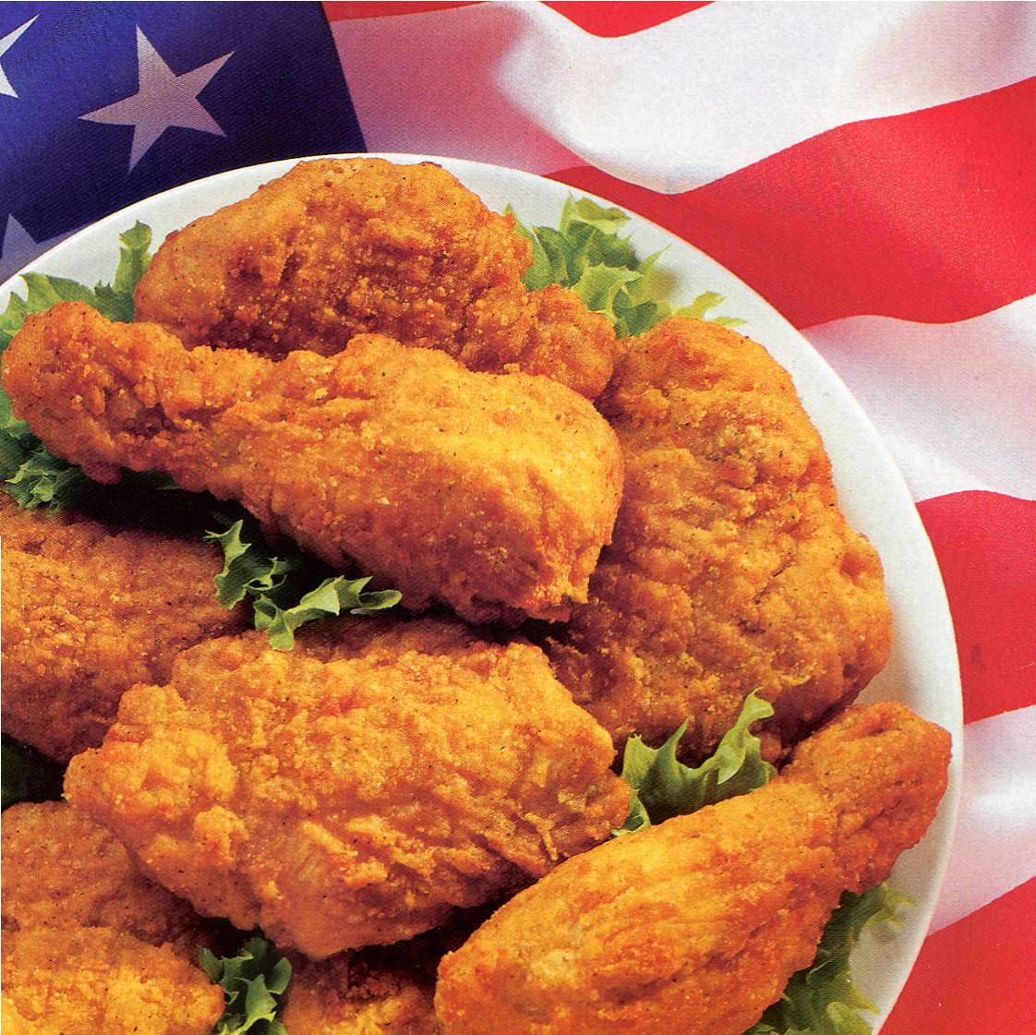
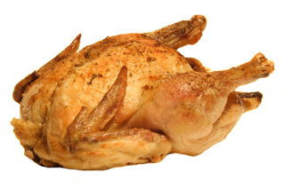
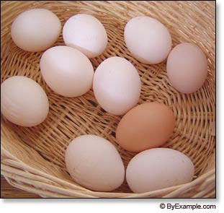

Slide 10
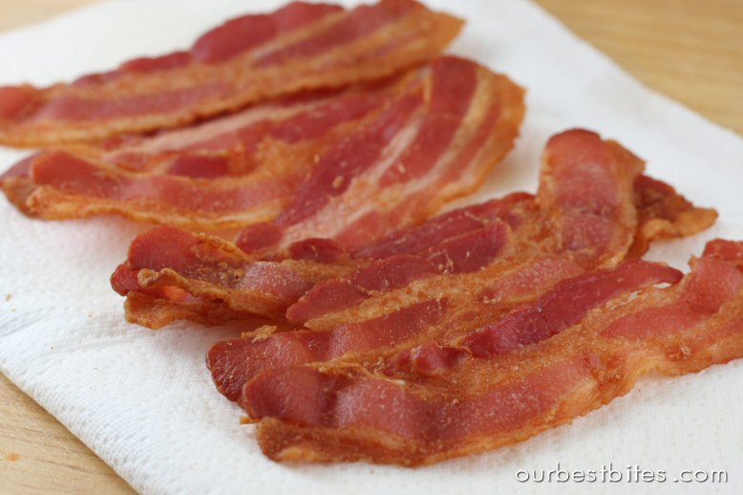
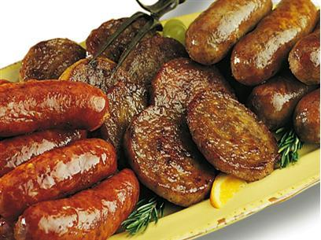
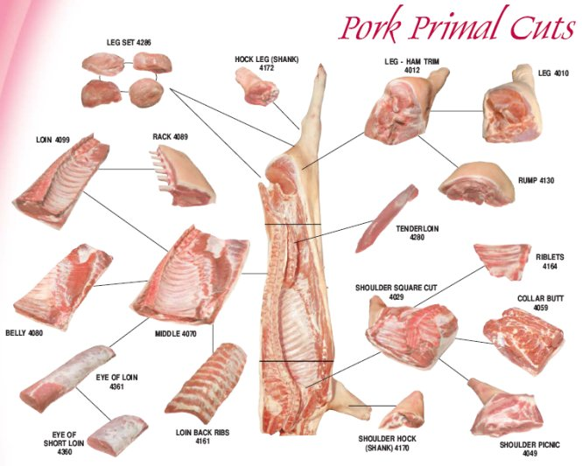
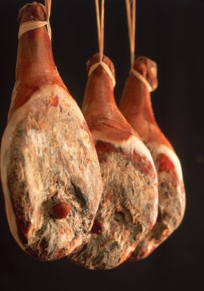

Slide 11
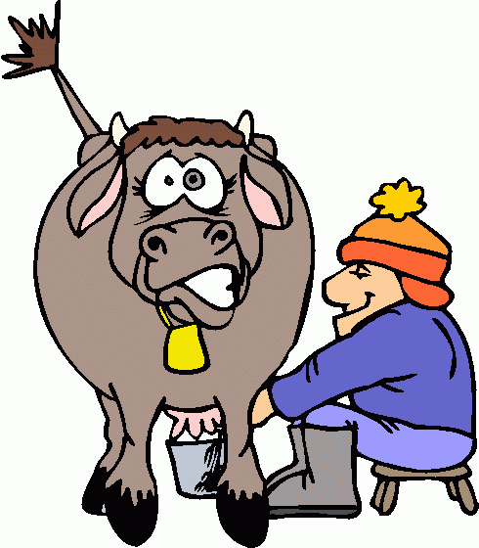
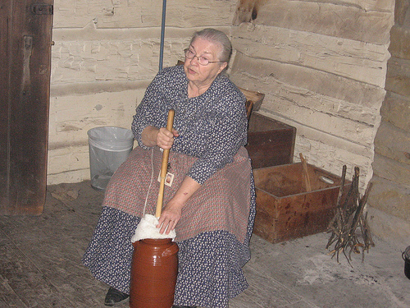

Slide 12
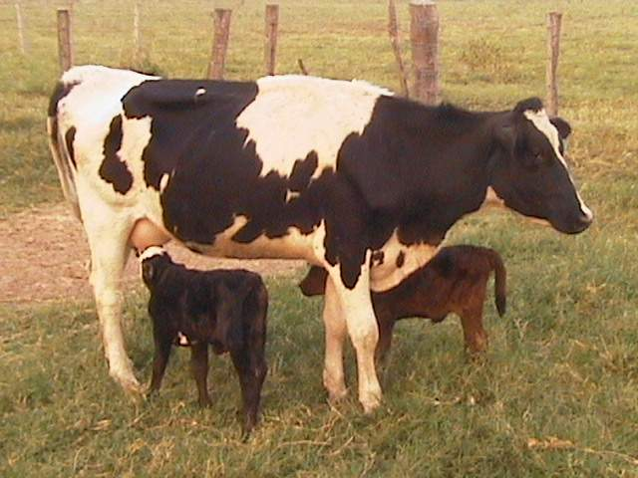
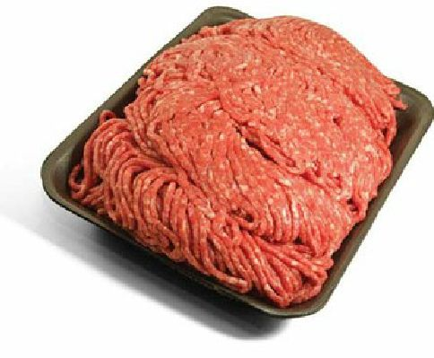
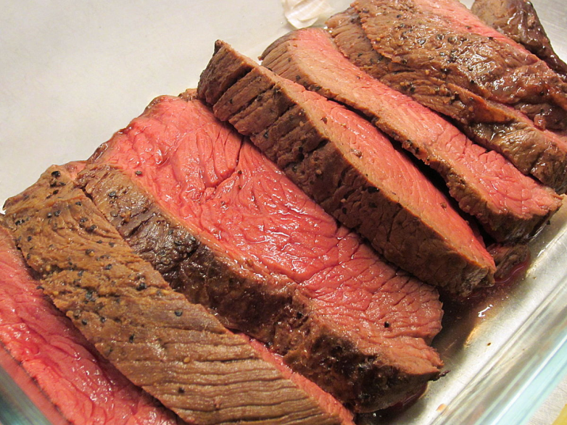
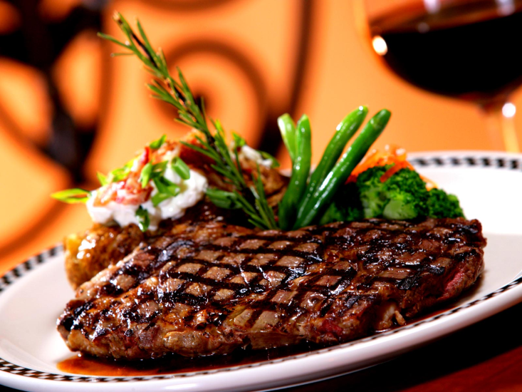
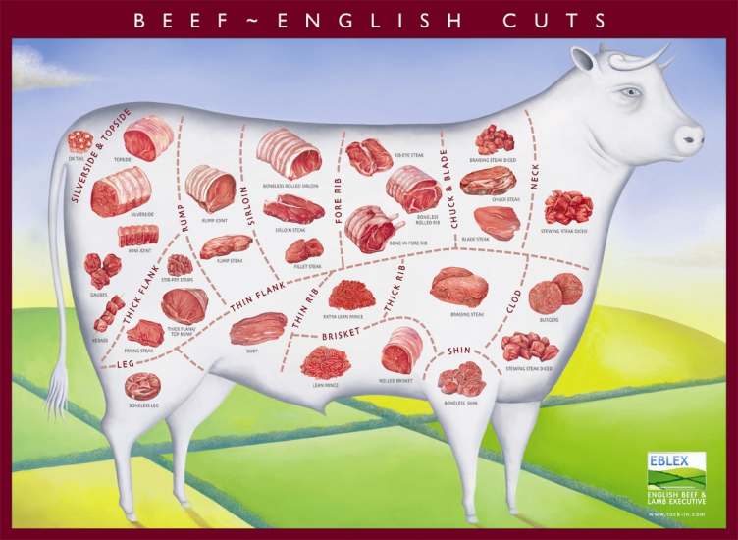

Slide 13
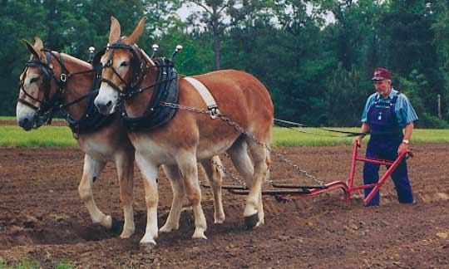
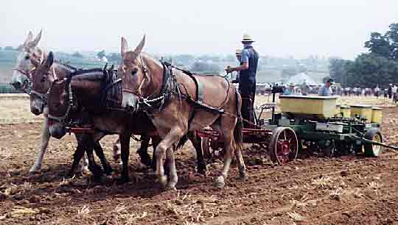
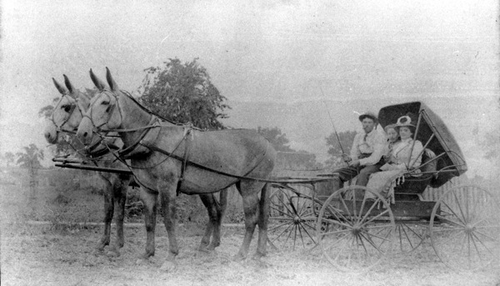

Slide 14
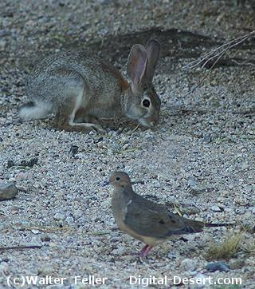
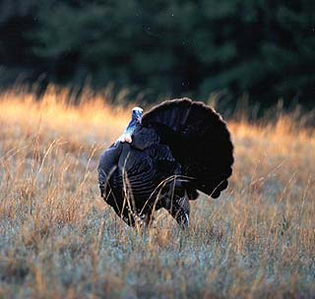
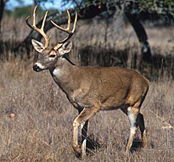
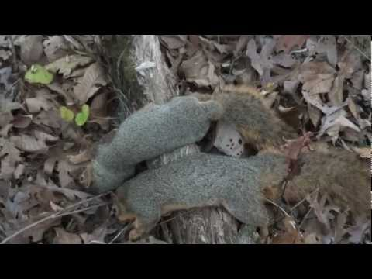
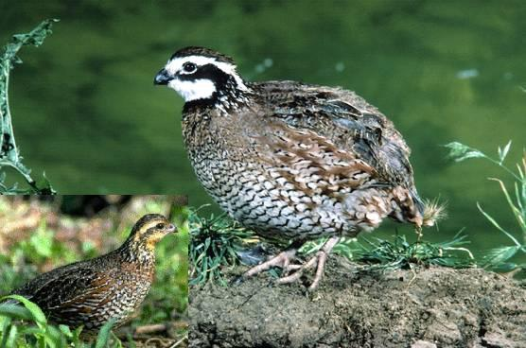
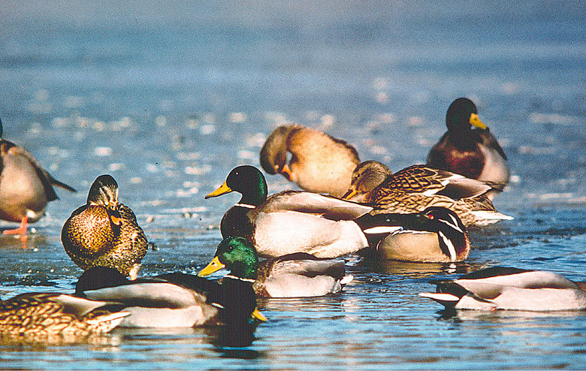

Slide 15
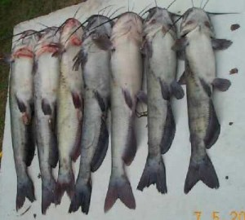
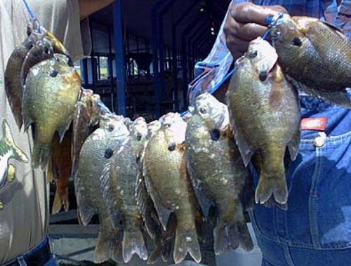
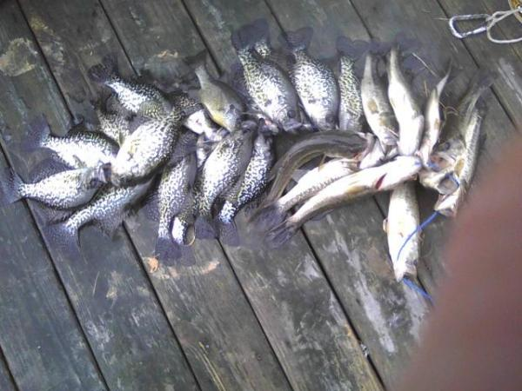
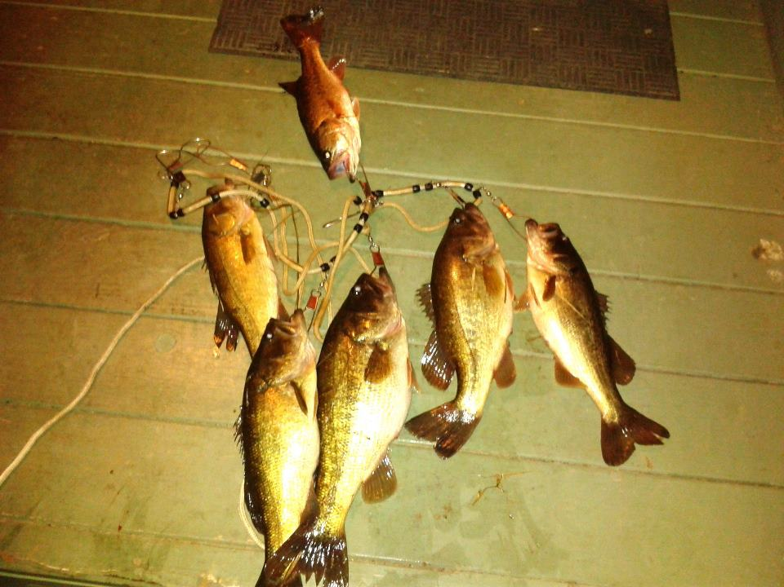

Slide 16
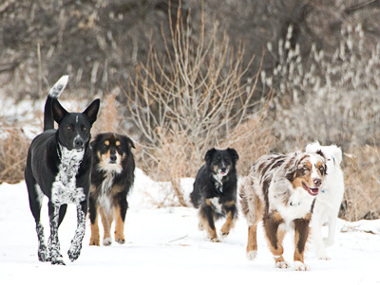
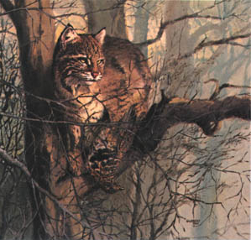
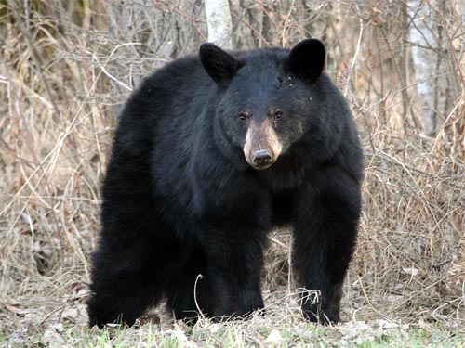
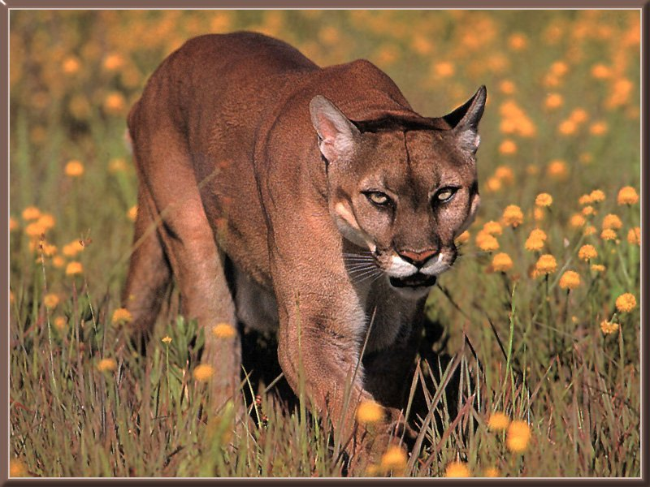
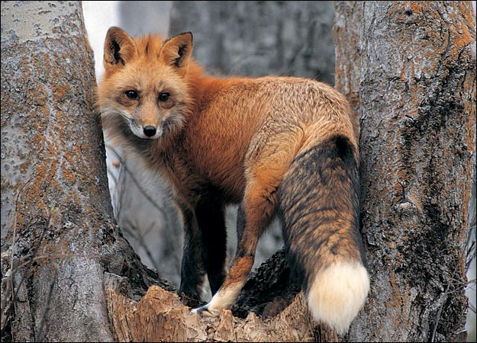

Slide 17
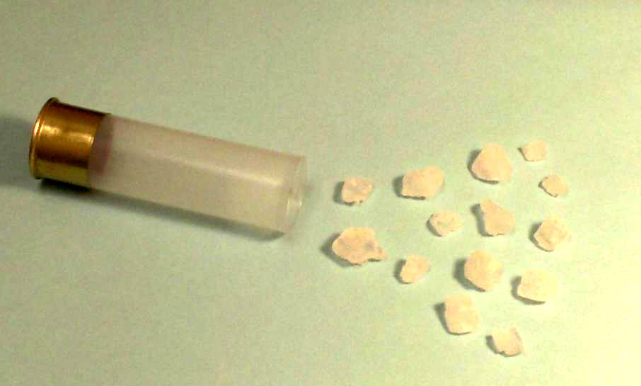
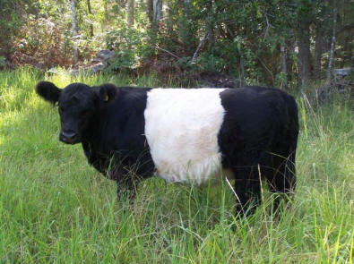
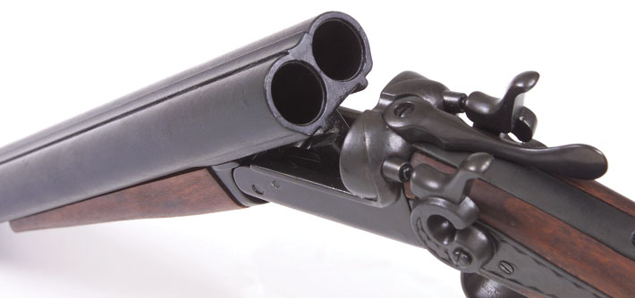
MOO

Slide 18
… Genesis 1:26-27 - 26 Then God said, "Let Us make man in Our image, according to Our likeness; and let them rule over the fish of the sea and over the birds of the sky and over the cattle and over all the earth, and over every creeping thing that creeps on the earth." NASU

Slide 19
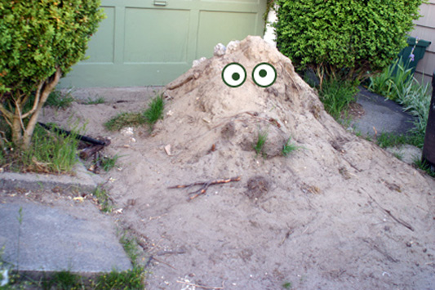
EVOLUTIONIST SAY

Slide 20
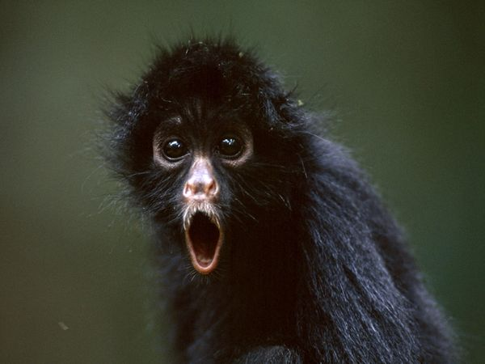
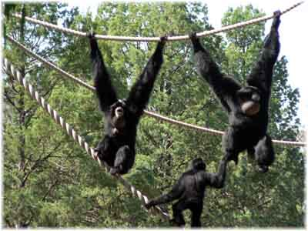
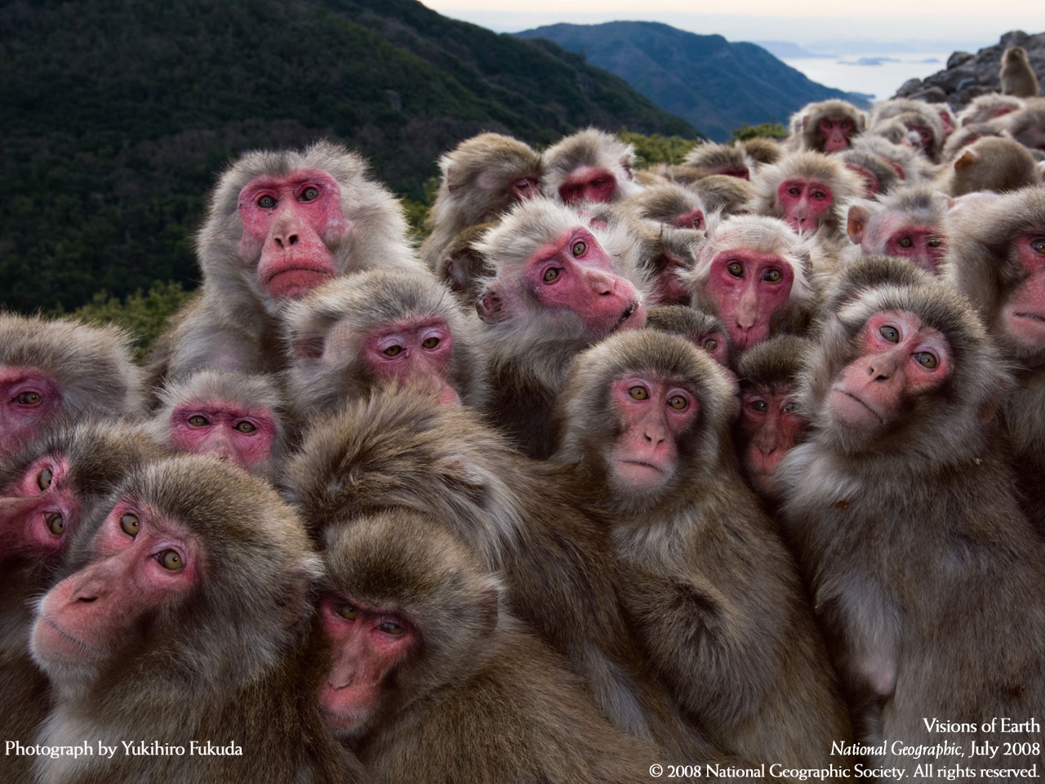

Slide 21
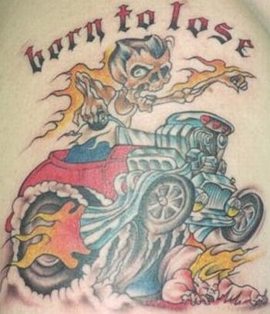
Because we are made in the image of God… we have intrinsic value. If only for that reason– we are WORTH something

Slide 22
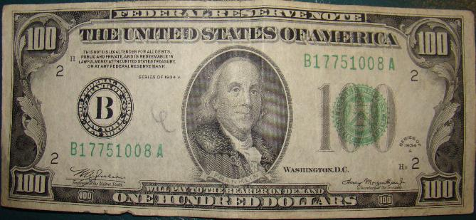
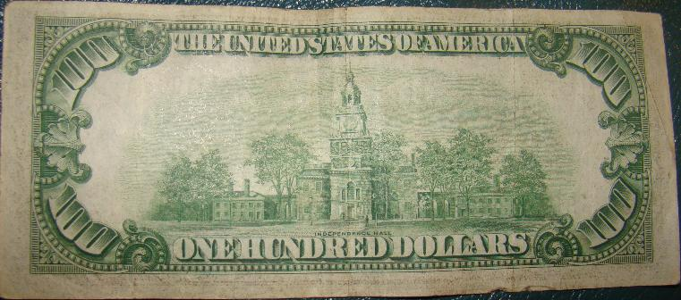

Slide 23
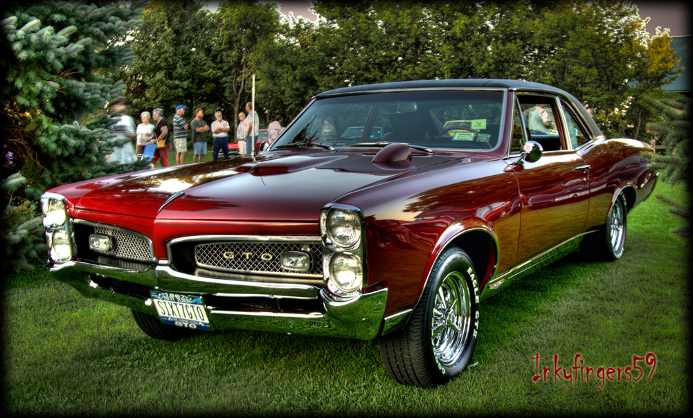
MADE IN THE IMAGE OF GOD

Slide 25
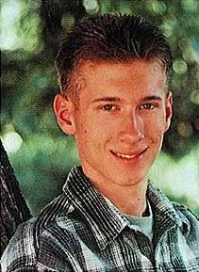
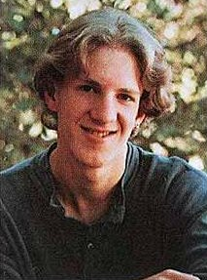
because we have been created in His image – we have a responsibility
“Cause, if that’s all you are, that’s all you’re going to be."
Eric Harris on April 20, 1999 - from 11:19 a.m. - 12:08 p.m. Kill 7 people and wounded 24 others.
Dylan Klebold on April 20, 1999 - from 11:19 a.m. - 12:08 p.m. killed 6 people and wounded 24 others.

Slide 26
- that’s just how I am
- I was born this way
- I can’t help myself
Essentially they’re saying I'm just dirt… not divine. They’re declaring “I wasn’t formed by God, I came from goop."

Slide 27
"Be holy because I, the LORD your God, am holy.” Leviticus 19:2
“Be merciful, just as your Father is merciful.” Luke 6:36
“Be perfect, therefore, as your heavenly Father is perfect.” Matthew 5:48

Slide 28
“to be complete” or “to be mature” –
Hebrews 5:14 - “But solid food is for the MATURE, who by constant use have trained themselves to distinguish good from evil.”

Slide 29
“In the same way, let your light shine before others, SO THAT they may see your good works and give glory to your Father who is in heaven.” Matthew 5:16 ESV

Slide 31
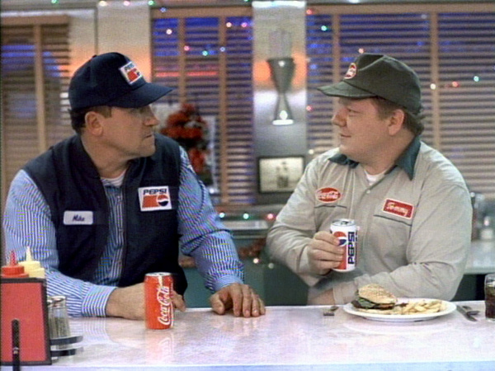
Who do these men work for? How do you know?

Slide 32
