Slide 2
Romans 12:11 (NASB) ¹¹ not lagging behind in diligence, fervent in spirit, serving the Lord;
Romans 12:11 (GW) ¹¹ Don't be lazy in showing your devotion. Use your energy to serve the Lord.
Romans 12:11 (NIV) ¹¹ Never be lacking in zeal, but keep your spiritual fervor, serving the Lord.
Romans 12:11 (NLT2) ¹¹ Never be lazy, but work hard and serve the Lord enthusiastically.

Slide 3
"I want you to love God with all your heart and soul and mind and strength. Nothing matters more than that. That’s the number one thing in life. I want you to love Me passionately."

Slide 4
Mark 11:30, from The Message "Jesus said, “Love the Lord God with all your passion and prayer and intelligence and energy.”

Slide 5
Colossians 3:23 – "Whatever you do, do it with all of your heart as unto the Lord and not unto men."

Slide 6
Romans 12:11- Never be lacking in zeal, but keep your spiritual fervor, serving the Lord. NIV

Slide 8
Psalm 127: 3- "It’s senseless for you to work so hard from early morning until late at night, fearing that you’re going to starve to death, for God wants His loved ones to get their proper rest."

Slide 9
COMPASSION FATIGUE

Slide 10
James 2:17 "To him who knoweth to do good and doeth it not it is sin."

Slide 11
Luke 12:48 – Everyone to whom much was given, of him much will be required, and from him to whom they entrusted much, they will demand the more. ESV

Slide 12
1 Timothy 4:7 "Take the time and trouble to keep yourself spiritually fit."

Slide 13
You need to have time to worship with God private and corporate.
You need to have times when you’re fellowshipping with other believers.
You need to have times when you’re reading God’s word and growing as a Christian.
You need to have times of ministry -- service -- where you’re giving out and using your abilities.
And you need times of mission where you’re sharing your faith with others.

Slide 14
II) AN UNUSED TALENT
1 Peter 4:10 - "Each of you has been blessed with one of God’s many wonderful gifts to be used in the service of others. So use your gifts well.“
1 Corinthians 7 "Each one should live his life with the gifts that the Lord has given him."

Slide 15
Matt 25:20-30 - And he who had received the five talents came forward, bringing five talents more, saying, 'Master, you delivered to me five talents; here I have made five talents more.' 21 His master said to him, 'Well done, good and faithful servant. You have been faithful over a little; I will set you over much. Enter into the joy of your master.' 22 And he also who had the two talents came forward, … 'Master, I knew you to be a hard man, reaping where you did not sow, and gathering where you scattered no seed, 25 so I was afraid, and I went and hid your talent in the ground. Here you have what is yours.' 26 But his master answered him, 'You wicked and slothful servant! You knew that I reap where I have not sowed and gather where I scattered no seed? 27 Then you ought to have invested my money with the bankers, and at my coming I should have received what was my own with interest. 28 So take the talent from him and give it to him who has the ten talents. 29 For to everyone who has will more be given, and he will have an abundance. But from the one who has not, even what he has will be taken away. 30 And cast the worthless servant into the outer darkness. In that place there will be weeping and gnashing of teeth.' ESV

Slide 16
III) UNCONFESSED SIN
Psalm 38:4 and 6 - "My guilt has overwhelmed me like a burden too heavy to bear... I am bowed down and I am brought low.“

Slide 17
Psalms 32:3-5
3 When I kept silent about my sin, my body wasted away
Through my groaning all day long.
4 For day and night Your hand was heavy upon me;
My vitality was drained away as with the fever heat of summer. Selah.
5 I acknowledged my sin to You,
And my iniquity I did not hide;
I said, "I will confess my transgressions to the Lord";
And You forgave the guilt of my sin.
NASU

Slide 18
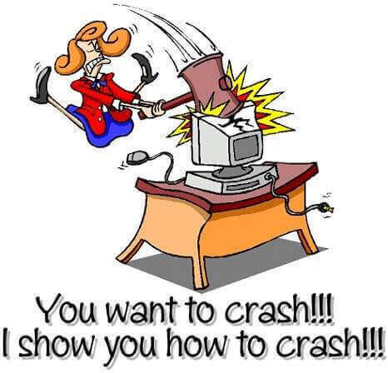

Slide 20
1 John 1:9 – "If we confess our sins He [God] can be trusted to forgive us our sins and to cleanse us from all unrighteousness."

Slide 21
IV) UNRESOLVED CONFLICT
RESENTMENT
JEALOUSLY
AND PROLONGED ANGER
Job 5:2 "Resentment destroys the fool and jealousy kills the simple."
Job 18:4 - "You are only hurting yourself with your anger."

Slide 22
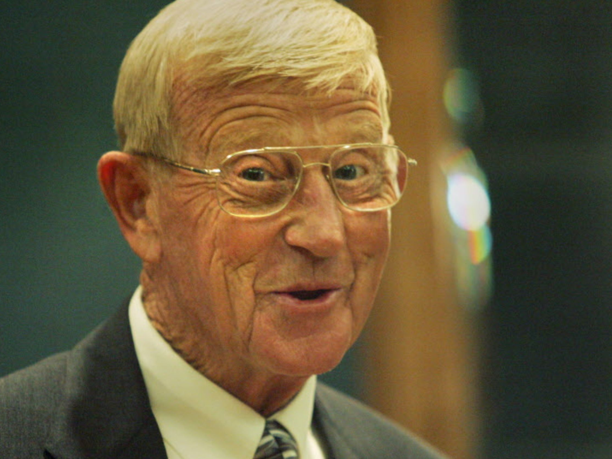
90% OF THE PEOPLE AROUND YOU DON’T CARE!!!
AND THE OTHER 10% ARE GLAD YOU HAVE THEM!

Slide 23
Rom 12:14- Bless those who persecute you; bless and do not curse them. ESV

Slide 24
Rom 12:17-21 - 17 Never pay back evil for evil to anyone. Respect what is right in the sight of all men. 18 If possible, so far as it depends on you, be at peace with all men. 19 Never take your own revenge, beloved, but leave room for the wrath of God, for it is written, "VENGEANCE IS MINE, I WILL REPAY," says the Lord. 20 "BUT IF YOUR ENEMY IS HUNGRY, FEED HIM, AND IF HE IS THIRSTY, GIVE HIM A DRINK; FOR IN SO DOING YOU WILL HEAP BURNING COALS ON HIS HEAD." 21 Do not be overcome by evil, but overcome evil with good. NASU

