Slide 1
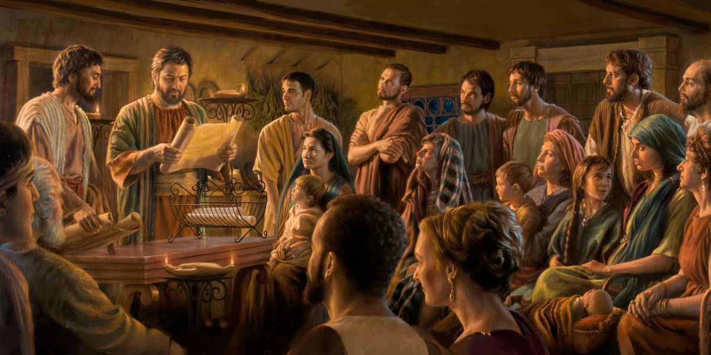
Music In the New Testament Church

Slide 2
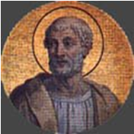
The Apostolic Fathers
The Apostolic Church Fathers were contemporaries of the apostles and were taught by them, carrying on the tradition and teachings they received from the apostles themselves.
Clement of Rome.

Slide 3
Philippians 4:2-3 (NASB) 2 I urge Euodia and I urge Syntyche to live in harmony in the Lord. 3 Indeed, true companion, I ask you also to help these women who have shared my struggle in the cause of the gospel, together with Clement also and the rest of my fellow workers, whose names are in the book of life.

Slide 4
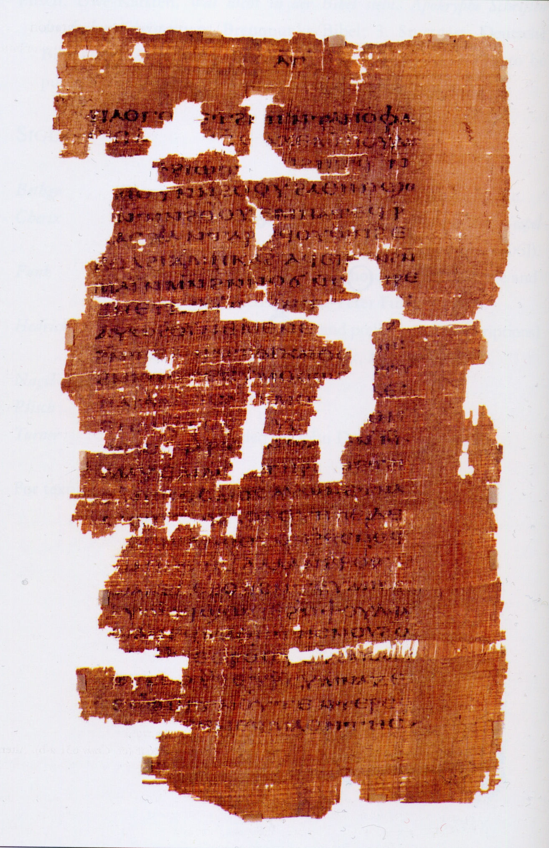
1st Epistle of Clement

Slide 5
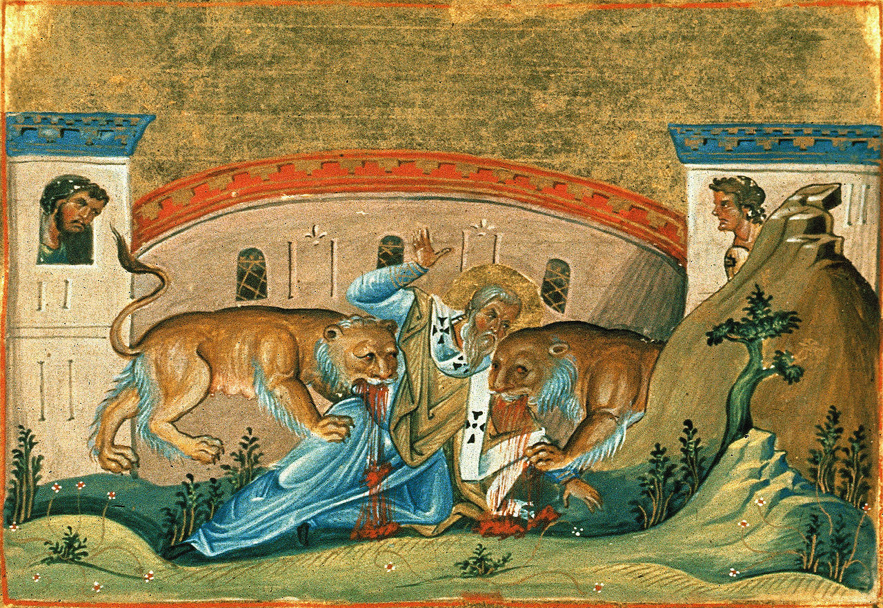
Ignatius of Antioch. (35 AD died 110 AD)

Slide 6
Polycarp of Smyrna. (c. AD 69 – c. 156)
His student Irenaeus wrote that he "was not only instructed by the apostles, and conversed with many who had seen the Lord, but was also appointed bishop by apostles in Asia and in the church in Smyrna"

Slide 7
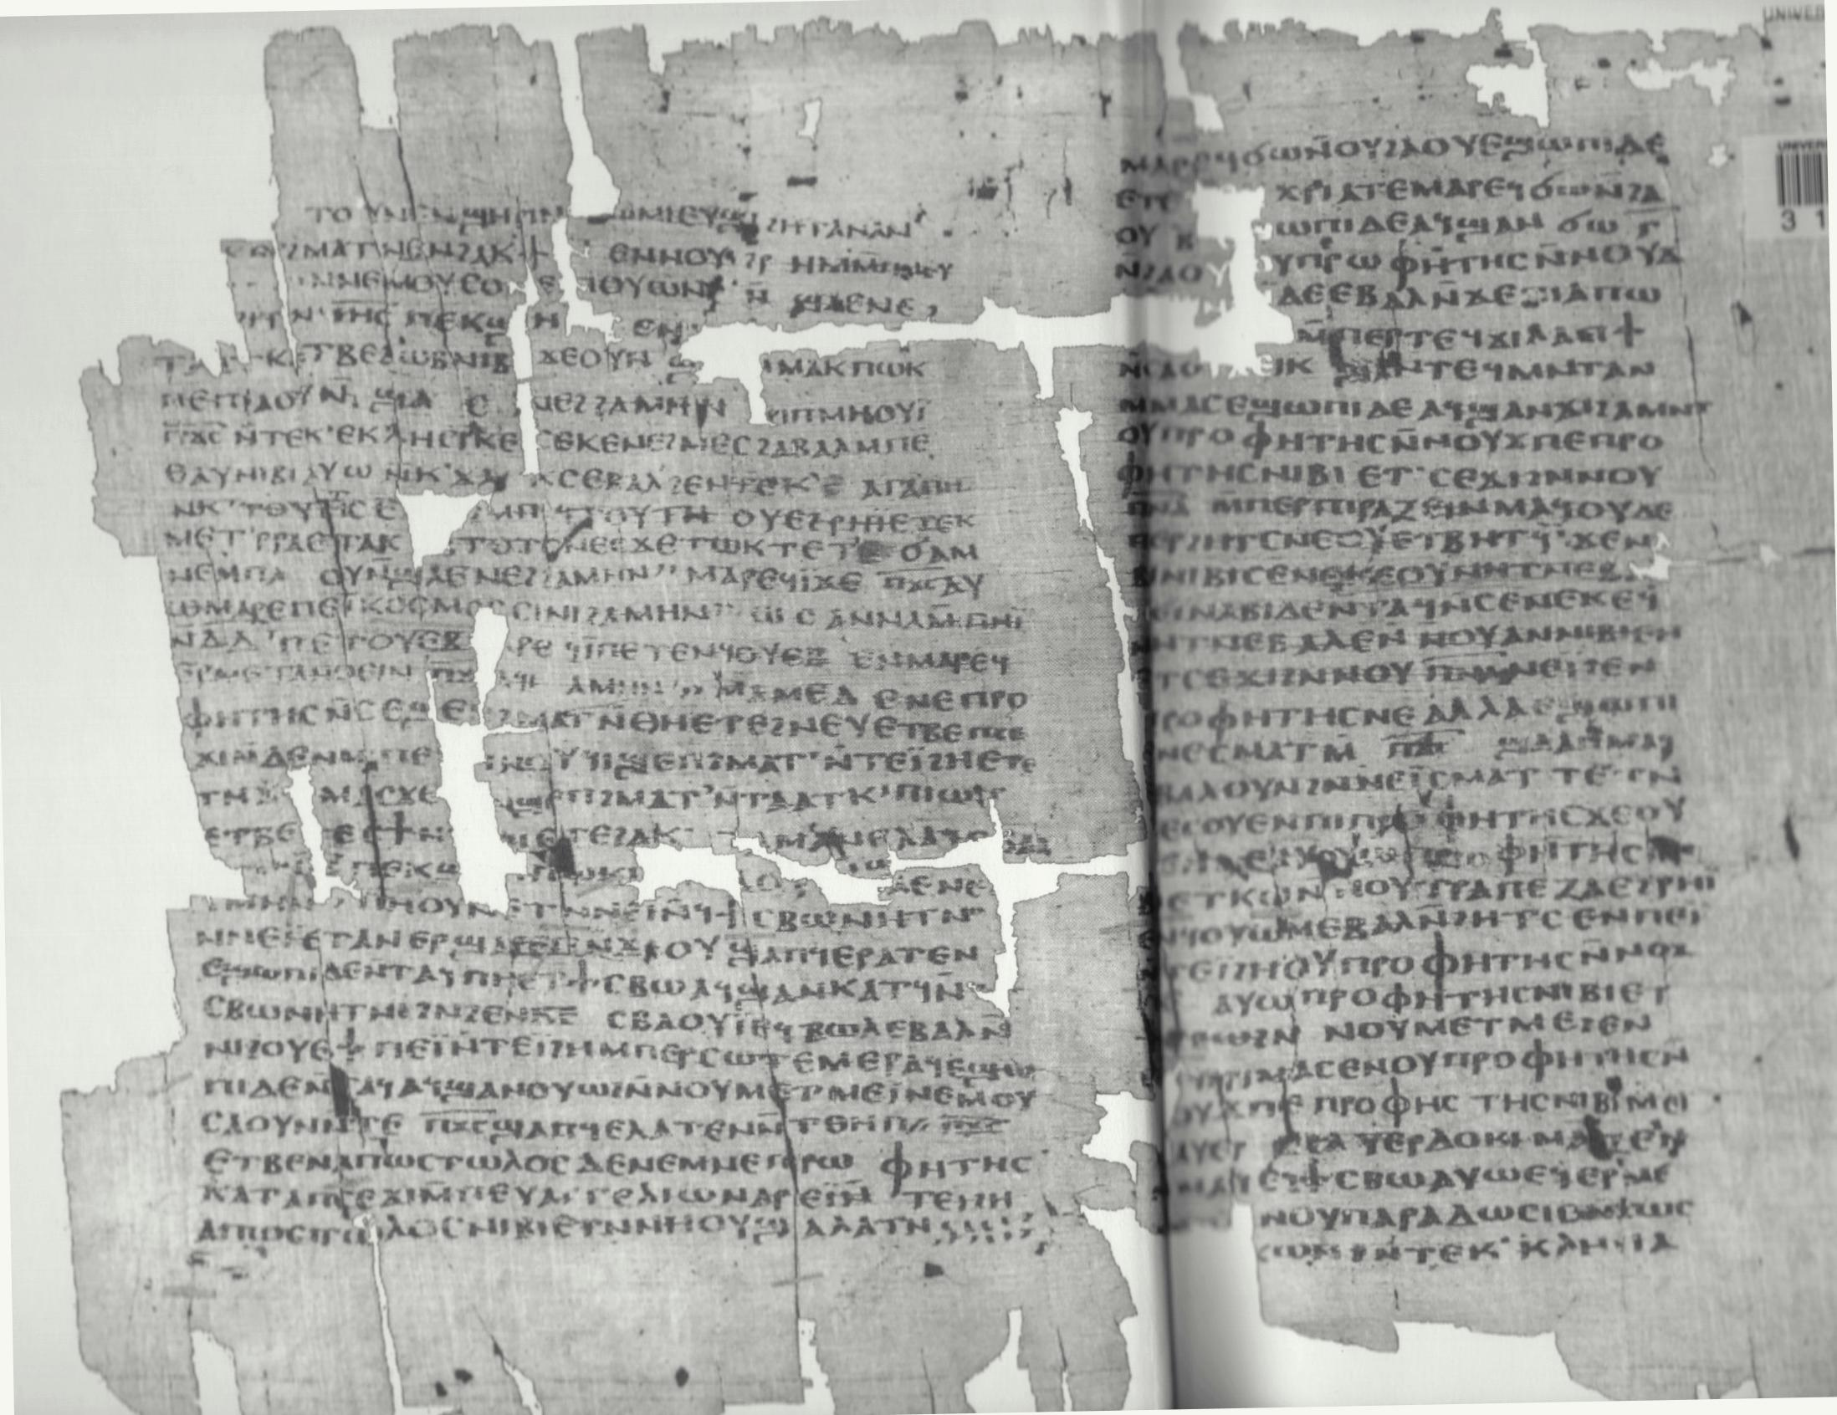
The Didache
This is an ancient book written to guide Christians in how they should practice their faith… written between 50 AD and the end of the 1st Century. “A reference book on moral precepts, instructions on organization of church communities, how to worship and contains the oldest prayer for communion, instructs on Baptism, fasting … “Has three main sections dealing with Christian lessons, rituals such as baptism and the Eucharist, and church organization.”

Slide 8
What do we know from these sources? The early church did not use instruments in worship. Not because they weren’t available, but because they believed singing, and the human voice were the instrument they were commanded to use to praise God. Instruments were also avoided because they were associated with idol and pagan worship, orgies, as well as Jewish worship.

Slide 9
The Church Fathers
History records that instruments were not adopted in worship until 1000 to 1200 years after Christ.
THOMAS AQUINAS Died in 1274 AD. "Our church does not use musical instruments, as harps and psalteries, to praise God withal, that she may not seem to Judaize." (Thomas Aquinas, Bingham's Antiquities, Vol. 3, page 137)

Slide 10
AUGUSTINE "musical instruments were not used. The pipe, tabret, and harp here associate so intimately with the sensual heathen cults, as well as with the wild revelries and shameless performances of the degenerate theater and circus, it is easy to understand the prejudices against their use in the worship." (Augustine 354 A.D., describing the singing at Alexandria under Athanasius)

Slide 11
CHRYSOSTOM - "David formerly sang songs, also today we sing hymns. He had a lyre with lifeless strings, the church has a lyre with living strings. Our tongues are the strings of the lyre with a different tone indeed but much more in accordance with piety. Here there is no need for the cithara, or for stretched strings, or for the plectrum, or for art, or for any instrument; but, if you like, you may yourself become a cithara, mortifying the members of the flesh and making a full harmony of mind and body. For when the flesh no longer lusts against the Spirit, but has submitted to its orders and has been led at length into the best and most admirable path, then will you create a spiritual melody." (Chrysostom, 347-407, Exposition of Psalms 41, (381-398 A.D.) Source Readings in Music History, ed. O. Strunk, W. W. Norton and Co.: New York, 1950, pg. 70.)

Slide 12
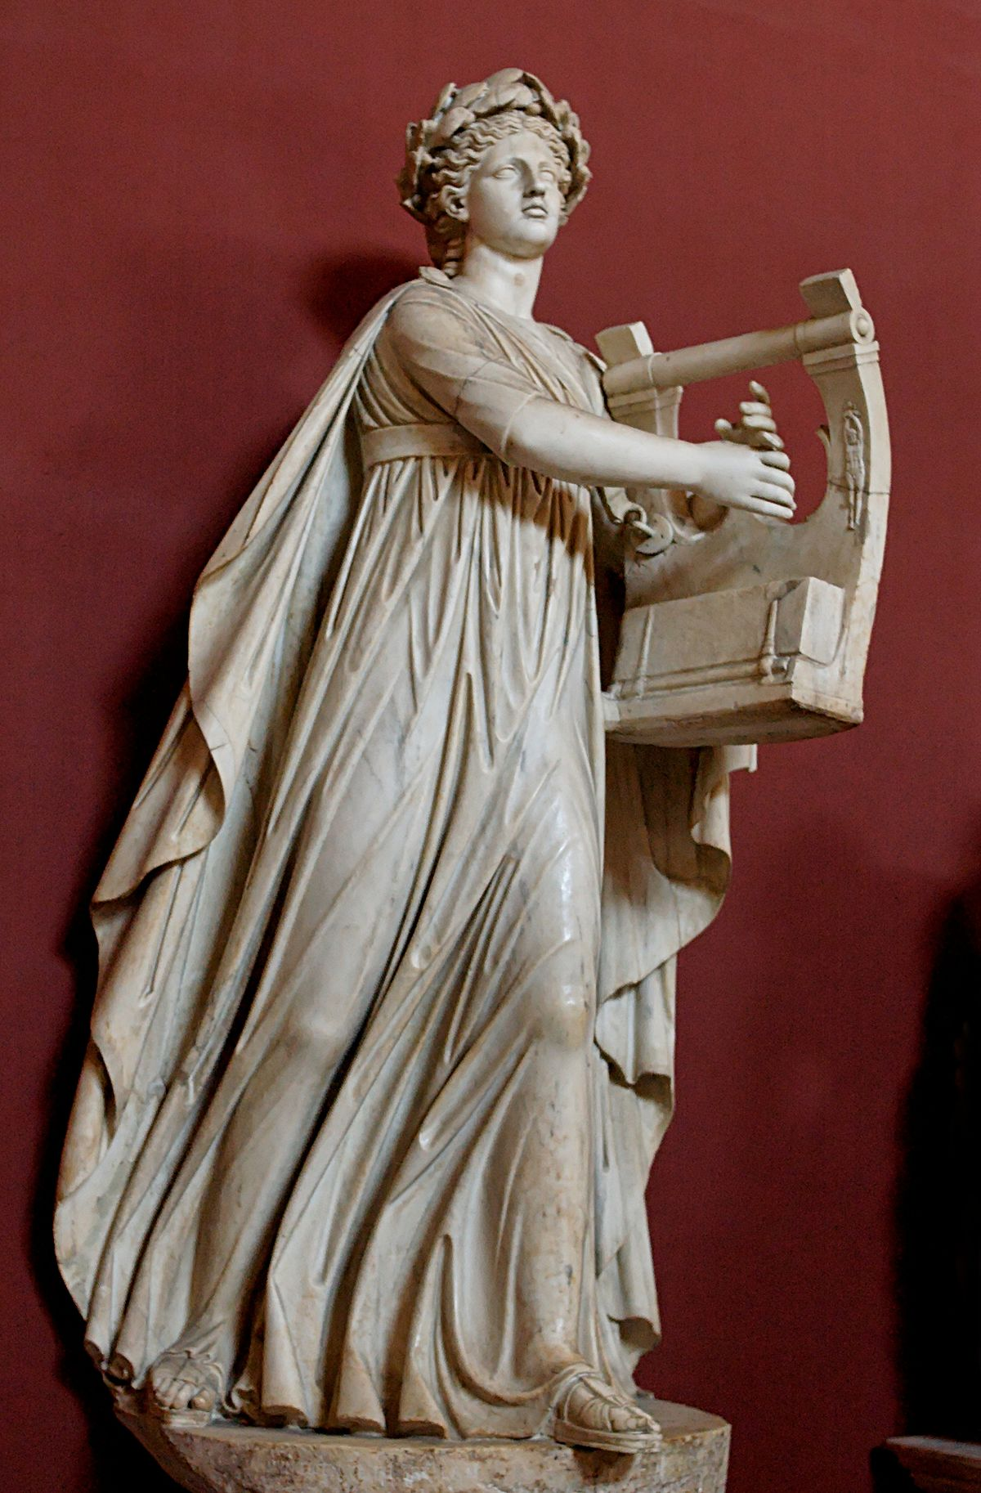
EUSEBIUS "Of old at the time those of the circumcision were worshipping with symbols and types it was not inappropriate to send up hymns to God with the psalterion and cithara and to do this on Sabbath days... We render our hymn with a living psalterion and a living cithara with spiritual songs. The unison voices of Christians would be more acceptable to God than any musical instrument. Accordingly in all the churches of God, united in soul and attitude, with one mind and in agreement of faith and piety we send up a unison melody in the words of the Psalms." (commentary on Psalms 91:2-3)
CITHARA

Slide 13
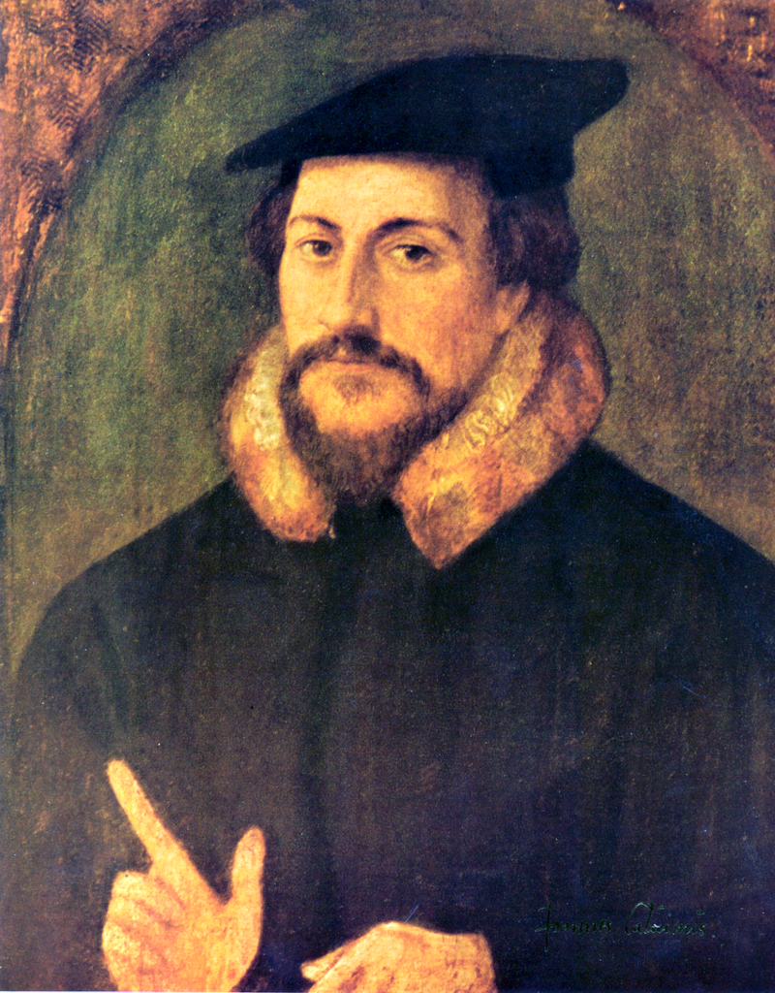
CALVIN "Musical instruments in celebrating the praises of God would be no more suitable than the burning of incense, the lighting of lamps, and the restoration of the other shadows of the law.”

Slide 14
FINNEY "The early Christians refused to have anything to do with the instrumental music which they might have inherited from the ancient world." (Theodore Finney, A History of Music, 1947, p. 43)

Slide 15
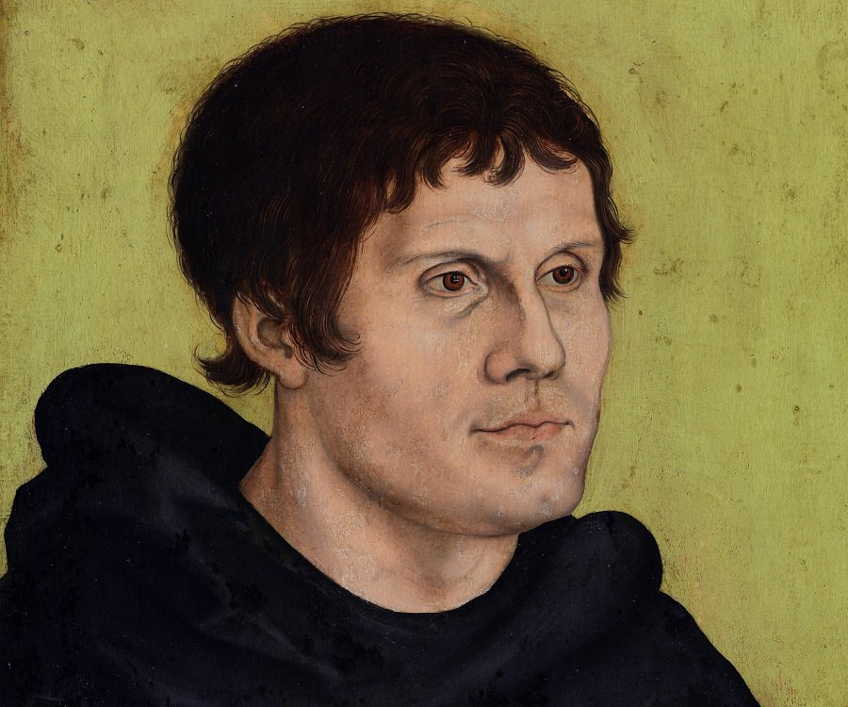
LUTHER "The organ in the worship is the insignia of Baal… The Roman Catholic borrowed it from the Jews." (Martin Luther, Mcclintock & Strong's Encyclopedia Volume VI, page 762)

Slide 16
LIPSCOMB "Neither he [Paul] nor any other apostle, nor the Lord Jesus, nor any of the disciples for five hundred years, used instruments. This too, in the face of the fact that the Jews had used instruments in the days of their prosperity and that the Greeks and heathen nations all used them in their worship. They were dropped out with such emphasis that they were not taken up till the middle of the Dark Ages and came in as part of the order of the Roman Catholic Church. It seems there cannot be doubt but that the use of instrumental music in connection with the worship of God, whether used as a part of the worship or as an attraction accompaniment, is unauthorized by God and violates the oft-repeated prohibition to add nothing to, take nothing from, the commandments of the Lord.

Slide 17
WHAT DOES THE NEW TESTAMENT TEACH?
"In reading the New Testament we find that early Christians were taught only to sing."
Music is mentioned in the New Testament in only a limited number of passages. But in each of the New Testament references where music is mentioned, it is singing which is specified.

Slide 18
Matthew 26.30: "And after singing a hymn, they went out to the Mount of Olives."
Acts 16.25: "About midnight Paul and Silas were praying and singing hymns of praise to God, and the prisoners were listening to them."
Romans 15.9: We find a quotation from the Psalms in which there is the expression: "Sing to Your name."

Slide 19
1 Corinthians 14.15: "I shall sing with the spirit and I shall sing with the mind also."
Ephesians 5.19: "Speaking to one another in psalms and hymns and spiritual songs, singing and making melody with your heart to the Lord."
Colossians 3.16: "Let the word of Christ richly dwell within you, with all wisdom teaching and admonishing one another with psalms and hymns and spiritual songs, singing with thankfulness in your heads to God."

Slide 20
Hebrews 2:12 - TO MY BRETHREN, IN THE MIDST OF THE CONGREGATION I WILL SING YOUR PRAISE."
James 5.13: "Is anyone among you suffering? Let him pray. Is anyone cheerful? Let him sing praises."

Slide 21
There are three passages in the book of Revelation where music is mentioned, but in these instances, it is used in a symbolic way to stand for something else.
Revelation 14.2- And I heard a voice from heaven, like the sound of many waters and like the sound of loud thunder, and the voice which I heard was like the sound of harpists playing on their harps. NASU

Slide 22
Each of the New Testament passages dealing with music in worship use the specific word "sing" rather than the general term "music" –
That limits us to doing only what the word "sing" allows.

Slide 23
Instrumental Music Was Not Used by the New Testament Church
Bible scholars and historians of all faiths agree on the absence of instrumental music IN the worship of the New Testament church.
Dr. Curt Sachs of Columbia University, one of the most eminent musicologists in America has said: "All ancient Christian music was vocal”

Slide 24
Dr. Frederic Ritter, in his book, History of Music From The Christian Era To The Present Time, writes "We have no real knowledge of the music which formed a part of the religious devotion of the first Christian congregations. It was, however, purely vocal."
The Encyclopedia of Religious Knowledge, in an article by J.M. Brown notes: "That instrumental music was not practiced by primitive Christians...is evident from church history."

Slide 25
The New Schaff-Herzog Encyclopedia of Religious Knowledge documents the fact that "...the organ...was rejected in early Christian circles."
McClintock and Strong observe: "The Greek word PSALLO is applied among the Greeks of modern times exclusively to sacred music, which in the Eastern Church has never been other than vocal; instrumental music being unknown in that church as it was in the primitive church."

Slide 26
The instrument was not accepted. As late as the 13th Century, noted Thomas Aquinas, a world-renowned Catholic scholar, was writing against its use.
It is worth it to remind us that when the Reformation began in Europe, one of the first abuses against which the Reformers took a stand was that of Instrumental Music.

Slide 27
Emil Nauman writes in The History of Music, Vol. I, p. 177: "There can be no doubt that originally the music of the divine service was everywhere entirely of a vocal nature."
Early Christian writers (Justin Martyr, Chrysostum, Tertullian, Eusebius) confirm that it was the practice of the early church simply to sing.

Slide 28
Those early Christians, who were guided by the Apostles, did not make use of mechanical instruments of music, but, rather, sang psalms, hymns, and spiritual songs to God.
This is historical as well as Biblical fact.
The New Testament Church sang vocal music. They did not use mechanical instruments in worship.

Slide 29
Reformation churches generally made three changes when they left the Catholic Church -
The altars were changed to communion tables
Religious statues were taken down
And Organs were thrown out.

Slide 30
Martin Luther called the organ "an ensign of Baal."
John Calvin said that Musical Instruments were "no more suitable than the burning of incense, the lighting of lamps, and the restoration of other shadows of the law."
John Knox called for Christianity to be purified of a "popish corruption" and urged the restoration of "plain singing of psalms unaccompanied by instrumental music."

Slide 31
John Wesley, who attempted further reformation in the Church of England in the 1700, and ended by establishing the Methodist Church, was also adamantly opposed to Instrumental Music.
Charles Spurgeon, perhaps the most famous preacher among the Baptists of the last century, refused to allow instrumental music in the Metropolitan Tabernacle in London where he preached to 10,000 weekly. He commented: "I would as soon pray to God with machinery as sing to God with machinery."

Slide 32
The famed Methodist scholar, Adam Clarke, wrote: "I am an old man, and an old minister; and I here declare that I never knew them (i.e. instruments) productive of any good in the worship of God; and have had reason to believe that they were productive of much evil. Music as a science, I esteem and admire; but instruments of music in the house of God I abominate and abhor."

Slide 33
The discord caused by the addition of the instrument to RCC worship services was so pronounced that the Pope quickly had them removed

Slide 34
The record of history is clear—wherever and whenever men have sought to purge Christianity of the innovations adopted by the Apostate Church, they have included the rejection of Instrumental Music.
All of the great reformers were agreed—returning to the simplicity of the New Testament Church meant dispensing with the use of Instruments in worship.

Slide 35
Instrumental Music introduces an Element of Divisiveness
Throughout history, instrumental music has been a disruptive issue and has often divided the church.
It has been the source of strife and much unnecessary division.
Yet few argue that it is essential to worship God in spirit and truth.

Slide 36
Can We Worship God In Spirit And Truth Without The Instrument?
The answer I’ve received has been an overwhelming yes!
Then if it is not essential to worship God…
If it is not authorized by the New Testament…
If the New Testament church did not used the instrument in worship…
And if it divides the church…
Then should we use it?

Slide 37
Instrumental Music is not sanctioned by the New Testament;
Instrumental Music was not used in the Early Church;
Instrumental Music originated in the Catholic Church; and
Instrumental Music is a source of strife and division.

