Slide 1
IS IT POSSIBLE TO IDENTIFY CHRIST’S CHURCH TODAY?
Matthew 16:15-18 (NASB) 15 He *said to them, "But who do you say that I am?" 16 Simon Peter answered, "You are the Christ, the Son of the living God." 17 And Jesus said to him, "Blessed are you, Simon Barjona, because flesh and blood did not reveal this to you, but My Father who is in heaven. 18 "I also say to you that you are Peter, and upon this rock I will build My church; and the gates of Hades will not overpower it.

Slide 2
John 17:20-21 - 20 "I do not ask on behalf of these alone, but for those also who believe in Me through their word; 21 that they may all be one; even as You, Father, are in Me and I in You, that they also may be in Us, so that the world may believe that You sent Me.
1 Cor 1:10- Now I exhort you, brethren, by the name of our Lord Jesus Christ, that you all agree and that there be no divisions among you, but that you be made complete in the same mind and in the same judgment.

Slide 3
Ephesians 4:1-6 - Therefore I, the prisoner of the Lord, implore you to walk in a manner worthy of the calling with which you have been called, 2 with all humility and gentleness, with patience, showing tolerance for one another in love, 3 being diligent to preserve the unity of the Spirit in the bond of peace. 4 There is one body and one Spirit, just as also you were called in one hope of your calling; 5 one Lord, one faith, one baptism, 6 one God and Father of all who is over all and through all and in all.

Slide 4
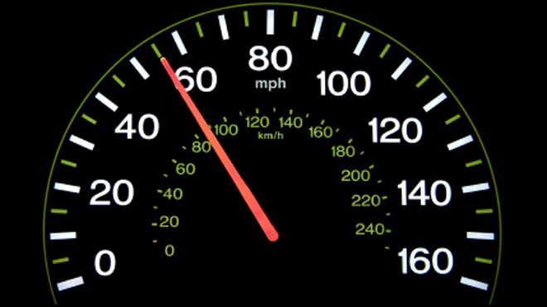
HOW DO YOU IDENTIFY THE CHURCH TODAY?

Slide 5
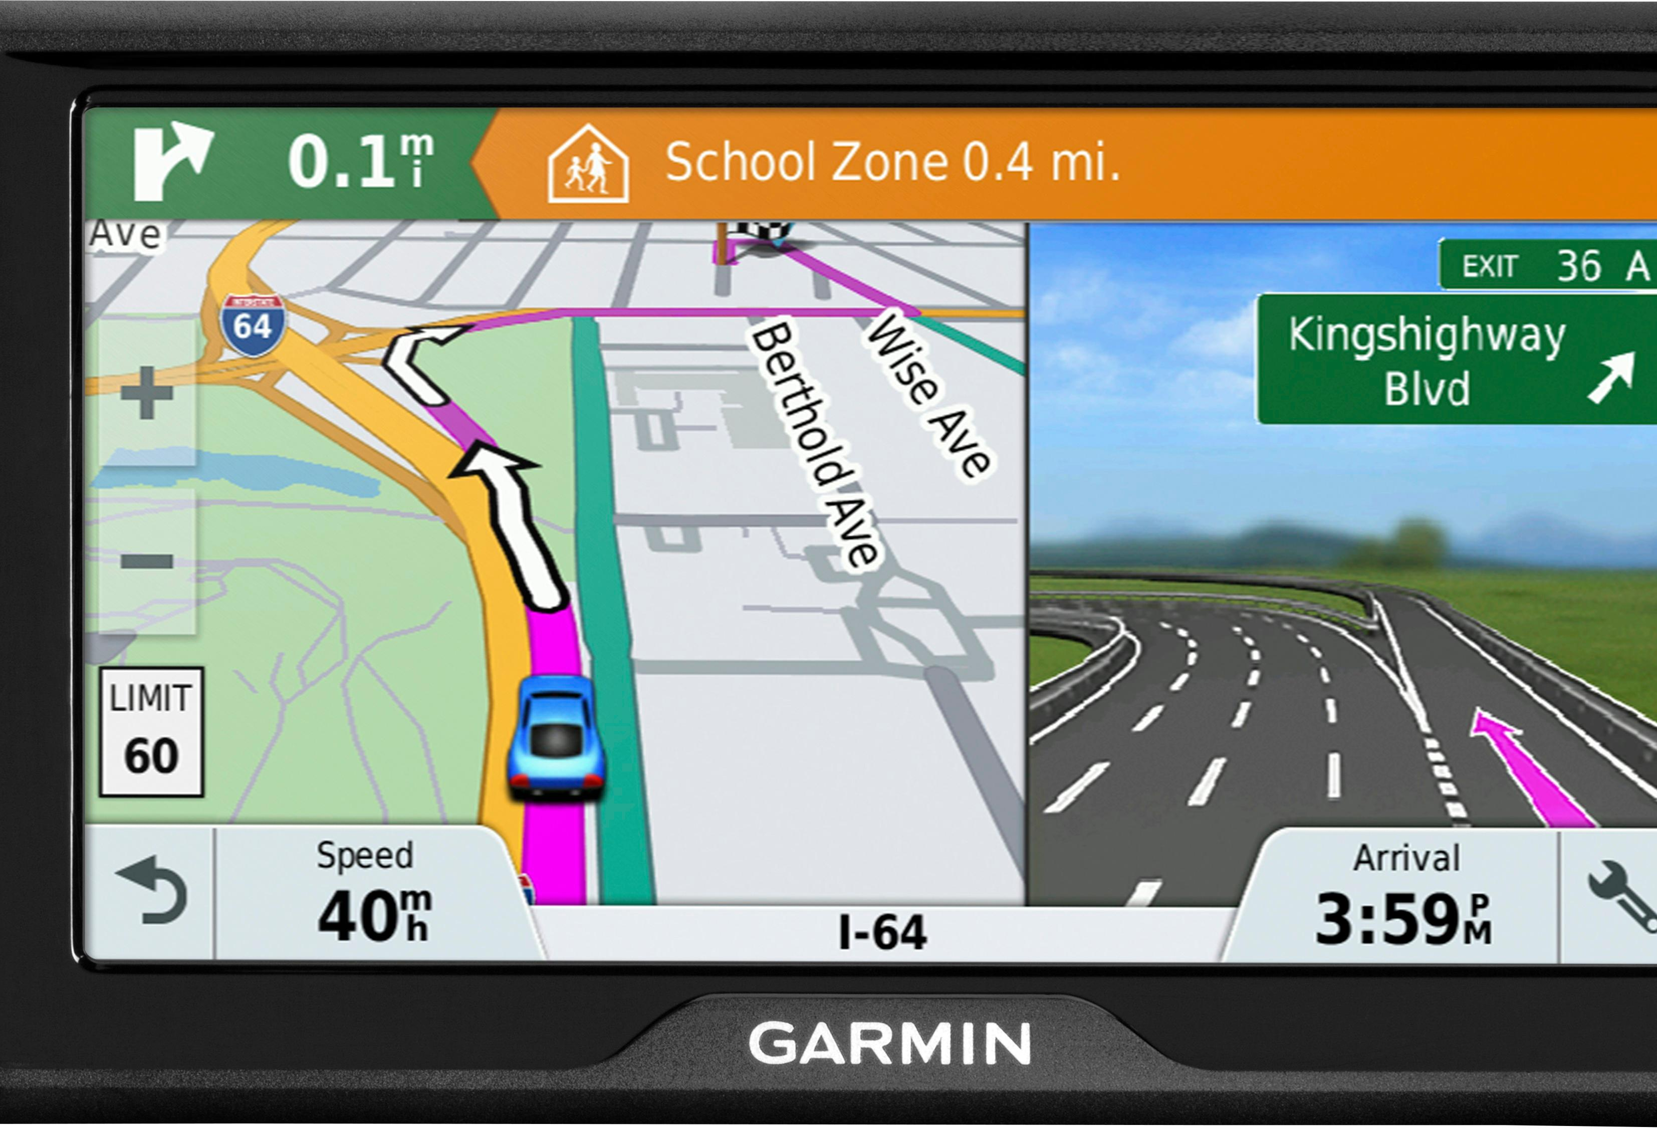

Slide 6
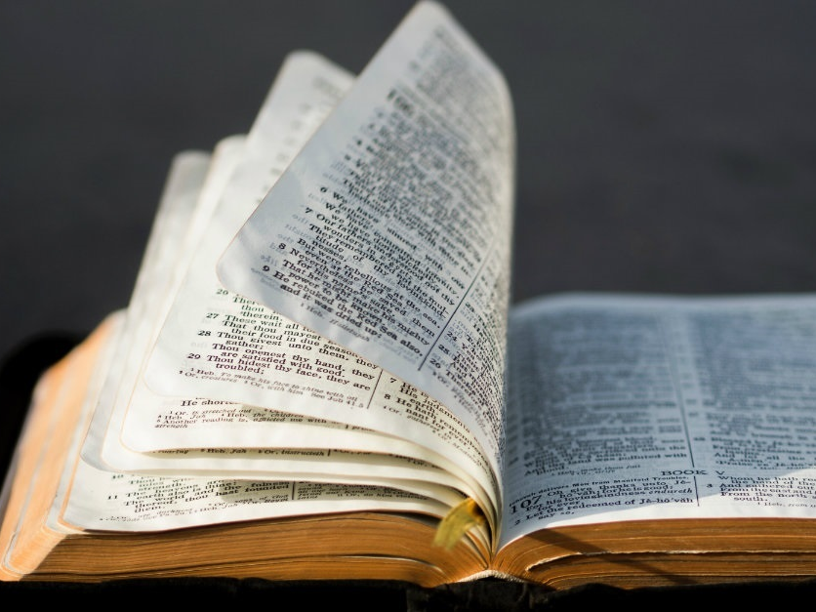
That right instrument is the Bible.

Slide 7
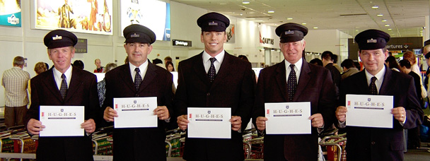

Slide 8
THE ORIGINAL CHURCH
… In the New Testament times a sinner had to be saved from their sins. At the point of salvation, the Lord added the person to his church. Acts 2:47
As we have studied people were instructed to meet five requirements for salvation and church membership.

Slide 9
Hear – Romans 10:17
This produced faith in Jesus Christ, the Son of God. John 8:24- 24 Therefore I said to you that you will die in your sins; for unless you believe that I am He, you will die in your sins."
Next they were instructed to repent of their sins. (to be sorry for and to turn from their sins)
They confessed their faith – Acts 8 – The Eunuch.
They were baptized into Christ, into his body. When baptized we are baptized into Christ and into His church at one and the same time.

Slide 11
THEN THAT IS NOT THE CHURCH OF THE BIBLE

Slide 12
The Original church worshipped God on the First Day of the week, or Sunday. Acts 2: 42 - 42 They were continually devoting themselves to the apostles' teaching and to fellowship, to the breaking of bread and to prayer. NASU
Acts 20:7 - 7 On the first day of the week, when we were gathered together to break bread, Paul began talking to them, intending to leave the next day, and he prolonged his message until midnight.

Slide 13
Called it “the Lord’s day.” Revelation 1:10 – “I was in the Spirit on the Lord's day…” NASU

Slide 14
When they worshiped they did the following
There was teaching or preaching from the Scriptures. This is why Paul instructed Timothy, a preacher, minister, evangelist in Ephesus … 2 Tim 2:15 - 15 Be diligent to present yourself approved to God as a workman who does not need to be ashamed, accurately handling the word of truth. NASU
The job of a preacher is to preach the Word. Teach the Word. 2 Tim 4:1-2 - I solemnly charge you in the presence of God and of Christ Jesus, who is to judge the living and the dead, and by His appearing and His kingdom: 2 preach the word; be ready in season and out of season; reprove, rebuke, exhort, with great patience and instruction.
1 Tim 4:13 - Until I come, devote yourself to the public reading of Scripture, to exhortation, to teaching.

Slide 15
The church was scripture based and scripture motivated
Acts 17:10-11 - 10 The brethren immediately sent Paul and Silas away by night to Berea, and when they arrived, they went into the synagogue of the Jews. 11 Now these were more noble-minded than those in Thessalonica, for they received the word with great eagerness, examining the Scriptures daily to see whether these things were so.
1 Corinthians 14:37 (NASB) 37 If anyone thinks he is a prophet or spiritual, let him recognize that the things which I write to you are the Lord's commandment.

Slide 16
Luke 10:16 - 16 "The one who listens to you listens to Me, and the one who rejects you rejects Me; and he who rejects Me rejects the One who sent Me."

Slide 17
1 Thessalonians 4:1-4 - Finally then, brethren, we request and exhort you in the Lord Jesus, that as you received from us instruction as to how you ought to walk and please God (just as you actually do walk), that you excel still more. 2 For you know what commandments we gave you by the authority of the Lord Jesus. 3 For this is the will of God, your sanctification; that is, that you abstain from sexual immorality…
1 Thessalonians 4:8 - 8 So, he who rejects this is not rejecting man but the God who gives His Holy Spirit to you.

Slide 18
1 Timothy 4:1-2 – But the Spirit explicitly says that in later times some will fall away from the faith, paying attention to deceitful spirits and doctrines of demons,

Slide 19
2 Timothy 4:3-5 - 3 For the time will come when they will not endure sound doctrine; but wanting to have their ears tickled, they will accumulate for themselves teachers in accordance to their own desires, 4 and will turn away their ears from the truth and will turn aside to myths. 5 But you, be sober in all things, endure hardship, do the work of an evangelist, fulfill your ministry.
John 14:15 - 15 "If you love Me, you will keep My commandments.

Slide 20
Deut 4:2-3 - 2 “You shall not add to the word which I am commanding you, nor take away from it, that you may keep the commandments of the Lord your God which I command you. NASU
Deut 12:32 - 32 "So be careful to obey all the commands I give you. You must not add anything to them or subtract anything from them. Holy Bible, New Living Translation.

Slide 21
There was a collection or giving
1 Cor 16:1-2 - Now concerning the collection for the saints, as I directed the churches of Galatia, so do you also. 2 On the first day of every week each one of you is to put aside and save, as he may prosper, so that no collections be made when I come.
2 Corinthians 8:7 - 7 But just as you excel in everything — in faith, in speech, in knowledge, in complete earnestness and in your love for us — see that you also excel in this grace of giving. NIV

Slide 22
Observed the Lord’s Supper -
Acts 20:7 - 7 On the first day of the week, when we were gathered together to break bread, Paul talked with them, intending to depart on the next day, and he prolonged his speech until midnight. ESV

Slide 23
1 Corinthians 11:17-22 - 17 But in giving this instruction, I do not praise you, because you come together not for the better but for the worse. 18 For, in the first place, when you come together as a church, I hear that divisions exist among you; and in part I believe it. 19 For there must also be factions among you, so that those who are approved may become evident among you. 20 Therefore when you meet together, it is not to eat the Lord's Supper, 21 for in your eating each one takes his own supper first; and one is hungry and another is drunk. 22 What! Do you not have houses in which to eat and drink? Or do you despise the church of God and shame those who have nothing? What shall I say to you? Shall I praise you? In this I will not praise you.

Slide 24
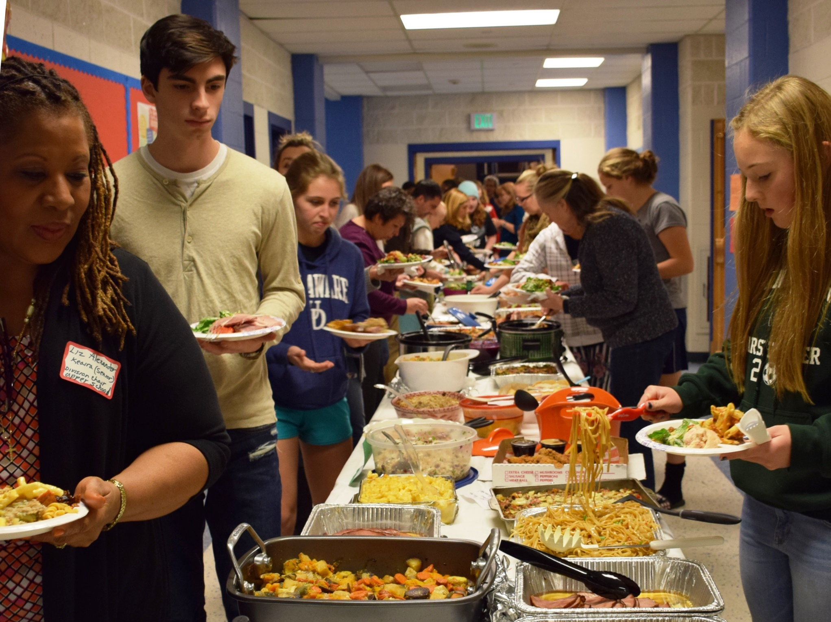

Slide 25
Prayed together.
1 Timothy 2:1-3 - I urge you, first of all, to pray for all people. As you make your requests, plead for God's mercy upon them, and give thanks. 2 Pray this way for kings and all others who are in authority, so that we can live in peace and quietness, in godliness and dignity. NLT

Slide 26
Sang praises to God.
(I owe you a lesson on this subject) 1 Corinthians 14:26- 26 What then, brothers? When you come together, each one has a hymn, a lesson, a revelation, a tongue, or an interpretation. Let all things be done for building up. ESV
Colossians 3:16- Let the word of Christ richly dwell within you, with all wisdom teaching and admonishing one another with psalms and hymns and spiritual songs, singing with thankfulness in your hearts to God.

Slide 27
The church of the Bible was organized with elders, deacons, evangelists/ministers.
Jesus is the head of the church. Eph 5:22-24 - 22 Wives, be subject to your own husbands, as to the Lord. 23 For the husband is the head of the wife, as Christ also is the head of the church, He Himself being the Savior of the body. 24 But as the church is subject to Christ, so also the wives ought to be to their husbands in everything. NASU
John 14:15 – “If you love me you will keep my commandments.”

Slide 28
Locally, the church was to have Elders -
1 Tim 3:1-7 - This is a trustworthy saying: "If someone aspires to be an elder, he desires an honorable position." 2 So an elder must be a man whose life is above reproach. He must be faithful to his wife. He must exercise self-control, live wisely, and have a good reputation. He must enjoy having guests in his home, and he must be able to teach. 3 He must not be a heavy drinker or be violent. He must be gentle, not quarrelsome, and not love money. 4 He must manage his own family well, having children who respect and obey him. 5 For if a man cannot manage his own household, how can he take care of God's church? 6 An elder must not be a new believer, because he might become proud, and the devil would cause him to fall. 7 Also, people outside the church must speak well of him so that he will not be disgraced and fall into the devil's trap. Holy Bible, New Living Translation.

Slide 29
These men were called elders, bishops, presbyters, overseers, pastors, and shepherds.

Slide 30
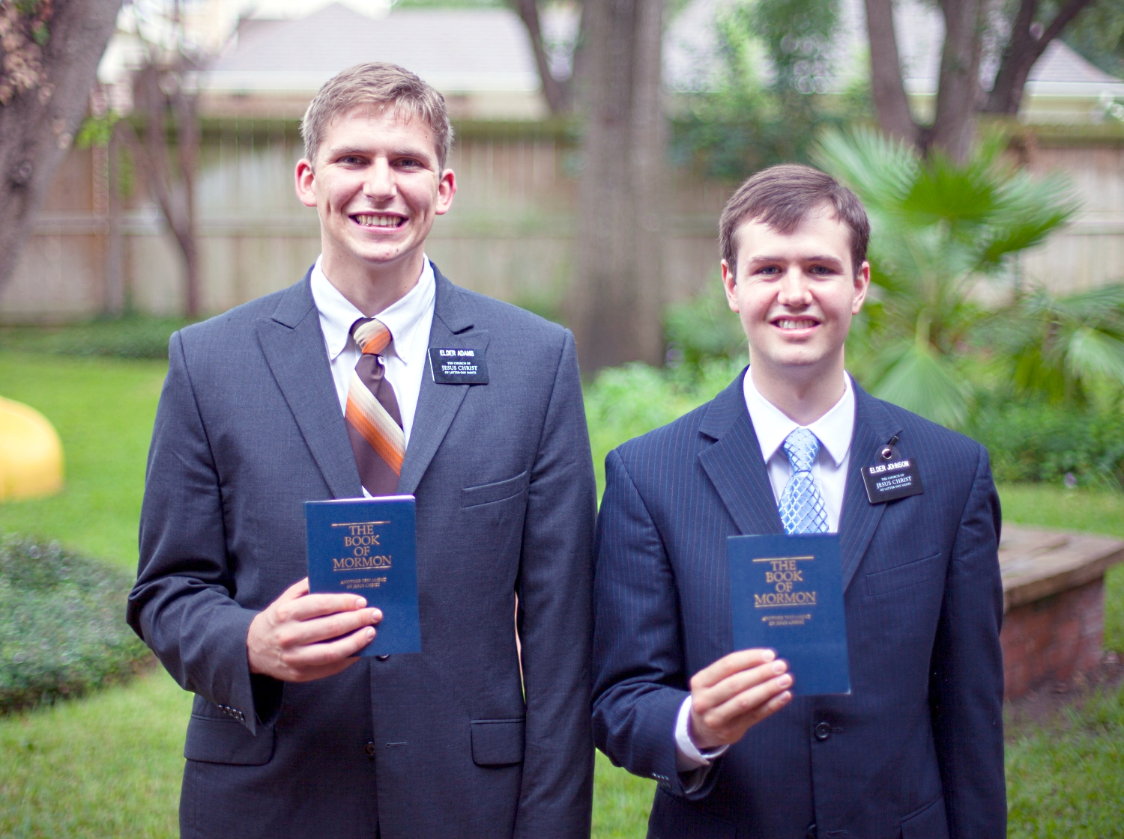

Slide 31
The headquarters of the church is where Jesus is – in Heaven.

Slide 32
The original church was given no particular name.
Denomination – from the Latin denomin – means to name a name.
Here’s the definition – “a naming, act of giving a name to, to name a name.”

Slide 33
It’s called the church, the body, the church of God, churches of Christ salute you, Christ’s body… the bride of Christ. The members of the church were simply called Christians.
Acts 11:26 - 26 and when he had found him, he brought him to Antioch. And for an entire year they met with the church and taught considerable numbers; and the disciples were first called Christians in Antioch.
Acts 26:28- 28 Agrippa replied to Paul, "In a short time you will persuade me to become a Christian."
1 Peter 4:16 - 16 but if anyone suffers as a Christian, he is not to be ashamed, but is to glorify God in this name.

Slide 34
Heb 12:23- 23 to the general assembly and church of the firstborn who are enrolled in heaven…

