Slide 1
IS IT POSSIBLE TO IDENTIFY CHRIST’S CHURCH TODAY?
Matthew 16:15-18 (NASB) 15 He *said to them, "But who do you say that I am?" 16 Simon Peter answered, "You are the Christ, the Son of the living God." 17 And Jesus said to him, "Blessed are you, Simon Barjona, because flesh and blood did not reveal this to you, but My Father who is in heaven. 18 "I also say to you that you are Peter, and upon this rock I will build My church; and the gates of Hades will not overpower it.

Slide 2
John 17:20-21 - 20 "I do not ask on behalf of these alone, but for those also who believe in Me through their word; 21 that they may all be one; even as You, Father, are in Me and I in You, that they also may be in Us, so that the world may believe that You sent Me.
1 Cor 1:10- Now I exhort you, brethren, by the name of our Lord Jesus Christ, that you all agree and that there be no divisions among you, but that you be made complete in the same mind and in the same judgment.

Slide 3
Ephesians 4:1-6 - Therefore I, the prisoner of the Lord, implore you to walk in a manner worthy of the calling with which you have been called, 2 with all humility and gentleness, with patience, showing tolerance for one another in love, 3 being diligent to preserve the unity of the Spirit in the bond of peace. 4 There is one body and one Spirit, just as also you were called in one hope of your calling; 5 one Lord, one faith, one baptism, 6 one God and Father of all who is over all and through all and in all.

Slide 4
ONE BODY
One Body. Ephesians 1:22-23 - 22 And He put all things in subjection under His feet, and gave Him as head over all things to the church, 23 which is His body, the fullness of Him who fills all in all.
Colossians 1:18 - 18 He is also head of the body, the church; and He is the beginning, the firstborn from the dead, so that He Himself will come to have first place in everything.

Slide 5
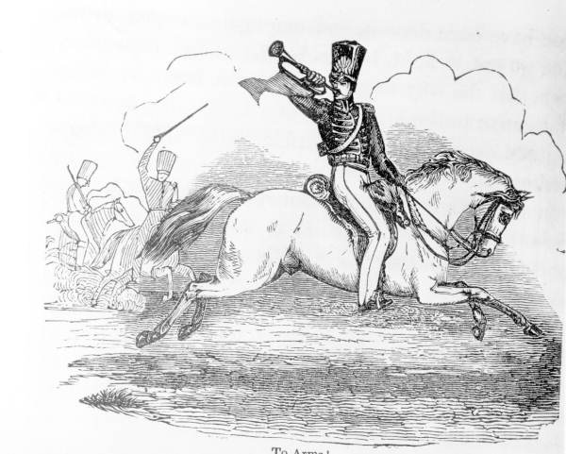
CLEAR BIBLICAL TEACHING MUST BE OUR GOAL.
John 8:31-32 - 31 “So Jesus was saying to those Jews who had believed Him, "If you continue in My word, then you are truly disciples of Mine; 32 and you will know the truth, and the truth will make you free."

Slide 6
PREACHING THE CHURCH WILL STRENGTHEN THE MEMBERS
“weak preaching makes weak Christians.”
“people do better when they are taught better.”
2 Cor 4:4 - in whose case the god of this world has blinded the minds of the unbelieving so that they might not see the light of the gospel of the glory of Christ, who is the image of God.

Slide 7
Acts 2:42 - 42 They were continually devoting themselves to the apostles' teaching and to fellowship, to the breaking of bread and to prayer.
Hebrews 5:12-14 - 12 For though by this time you ought to be teachers, you have need again for someone to teach you the elementary principles of the oracles of God, and you have come to need milk and not solid food. 13 For everyone who partakes only of milk is not accustomed to the word of righteousness, for he is an infant. 14 But solid food is for the mature, who because of practice have their senses trained to discern good and evil.

Slide 8
TO BE UNITED WE MUST HAVE A TRUE UNDERSTANDING OF THE CHURCH
1 Peter 2:9 (NASB) - 9 But you are A CHOSEN RACE, A royal PRIESTHOOD, A HOLY NATION, A PEOPLE FOR God's OWN POSSESSION, so that you may proclaim the excellencies of Him who has called you out of darkness into His marvelous light;
Genesis 15:16 (ESV) 16 And they shall come back here in the fourth generation, for the iniquity of the Amorites is not yet complete.”

Slide 9
SO THAT YOU MAY PROCLAIM THE EXCELLENCIES OF HIM WHO HAS CALLED YOU OUT OF DARKNESS INTO HIS MARVELOUS LIGHT…

Slide 10
WHY IS THE CHURCH SO IMPORTANT?
God has located salvation in Christ’s body. In the church. Ephesians 1:7 - 7 In Him we have redemption through His blood, the forgiveness of our trespasses, according to the riches of His grace 8 which He lavished on us. NASU
Ephesians 5:23-25 - 23 For the husband is the head of the wife, as Christ also is the head of the church, He Himself being the Savior of the body. 24 But as the church is subject to Christ, so also the wives ought to be to their husbands in everything. 25 Husbands, love your wives, just as Christ also loved the church and gave Himself up for her, NASU

Slide 11
Jesus is the Savior of the body. He purchased only one church.
He can only have one bride. Rom 7:4 - 4 Therefore, my brethren, you also were made to die to the Law through the body of Christ, so that you might be joined to another, to Him who was raised from the dead, in order that we might bear fruit for God.
2 Cor 11:2-4 - 2 For I am jealous for you with the jealousy of God himself. I promised you as a pure bride to one husband—Christ. 3 But I fear that somehow your pure and undivided devotion to Christ will be corrupted, just as Eve was deceived by the cunning ways of the serpent. Holy Bible, New Living Translation.

Slide 12
It’s true that a man can be saved outside of any denomination.
But you and I cannot be saved outside of the body of Jesus Christ. We must be in His body/church.
Jesus purchased the church with His own blood. Acts 20:28 - 28 Be on guard for yourselves and for all the flock, among which the Holy Spirit has made you overseers, to shepherd the church of God which He purchased with His own blood.

Slide 13
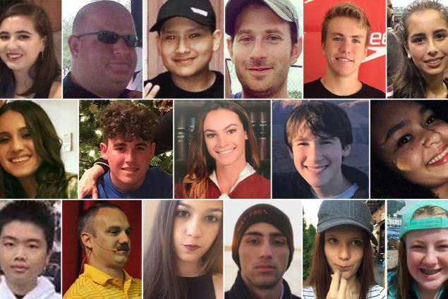

Slide 14
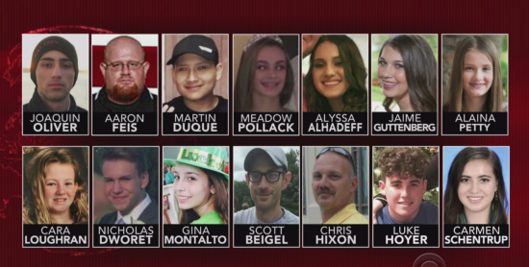

Slide 15
READ YOUR BIBLE. You don’t read of Baptist, Methodist, Lutheran, Presbyterian, Episcopalian, Catholic, Mormon, Jehovah’s Witnesses, and on and on.

Slide 16
OVER 38,000 DENOMINATIONS

Slide 17
The church is made up of, comprised of, consists of the saved.
Acts 2:41 – “Then those that received His word were baptized and there was added about three thousand souls.”
Acts 2:47 – “Praising God and having favor with all of the people and the Lord added to the church daily those who were being saved.”
1 Corinthians 12:13 - 13 For by one Spirit we were all baptized into one body.

Slide 18
“and the Lord added to the church daily such as should be saved.”

Slide 19
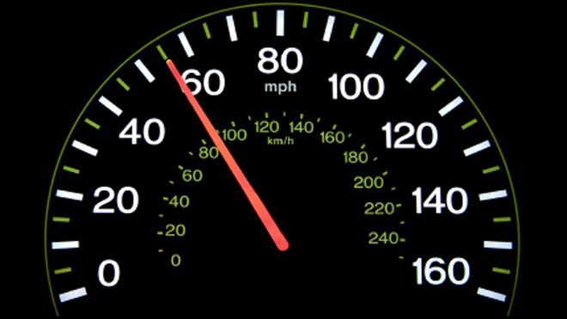
HOW DO YOU IDENTIFY THE CHURCH TODAY?

Slide 20
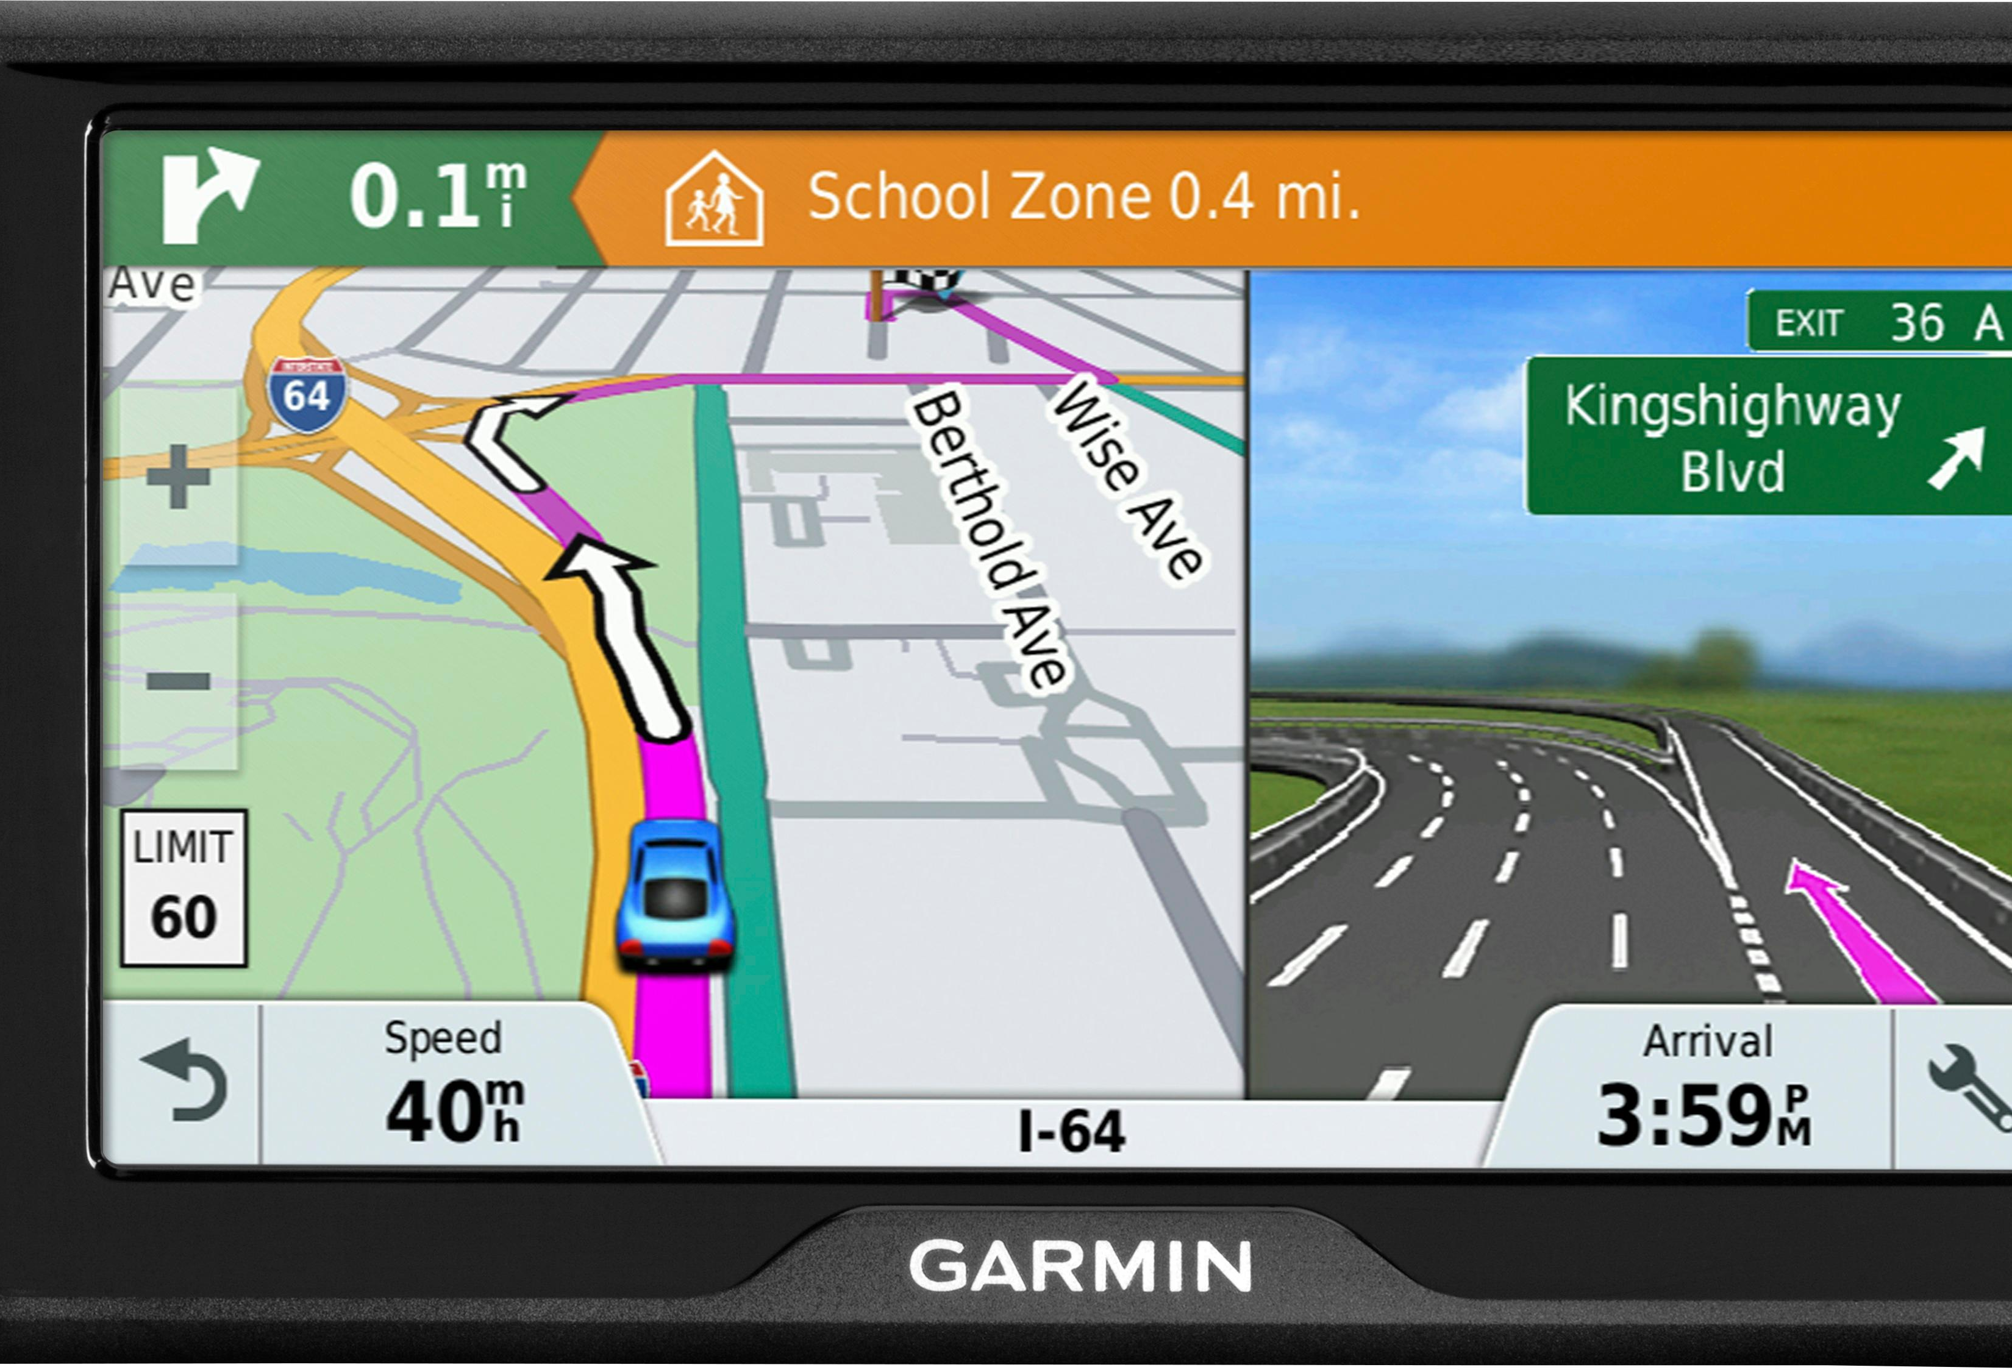

Slide 21
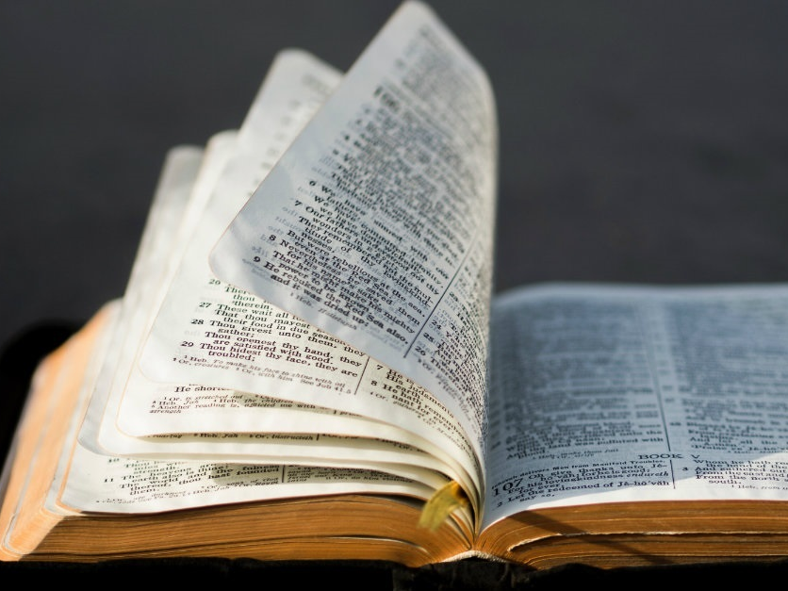
That right instrument is the Bible.

Slide 22
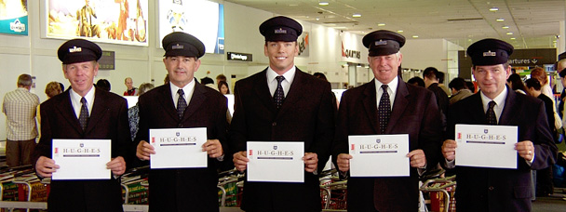

Slide 23
THE ORIGINAL CHURCH
… In the New Testament times a sinner had to be saved from their sins. At the point of salvation, the Lord added the person to his church. Acts 2:47
As we have studied people were instructed to meet five requirements for salvation and church membership.

Slide 24
Hear – Romans 10:17
This produced faith in Jesus Christ, the Son of God. John 8:24- 24 Therefore I said to you that you will die in your sins; for unless you believe that I am He, you will die in your sins."
Next they were instructed to repent of their sins. (to be sorry for and to turn from their sins)
They confessed their faith – Acts 8 – The Eunuch.
They were baptized into Christ, into his body. When baptized we are baptized into Christ and into His church at one and the same time.

Slide 25
THEN THAT IS NOT THE CHURCH OF THE BIBLE.

Slide 26
The Original church worshipped God on the First Day of the week, or Sunday. Acts 2: 42 - 42 They were continually devoting themselves to the apostles' teaching and to fellowship, to the breaking of bread and to prayer. NASU
Acts 20:7 - 7 On the first day of the week, when we were gathered together to break bread, Paul began talking to them, intending to leave the next day, and he prolonged his message until midnight.

Slide 27
When they worshiped they did the following
There was teaching or preaching from the Scriptures. 2 Tim 2:15 - 15 Be diligent to present yourself approved to God as a workman who does not need to be ashamed, accurately handling the word of truth. NASU
2 Tim 4:1-2 - I solemnly charge you in the presence of God and of Christ Jesus, who is to judge the living and the dead, and by His appearing and His kingdom: 2 preach the word; be ready in season and out of season; reprove, rebuke, exhort, with great patience and instruction.
1 Tim 4:13 - Until I come, devote yourself to the public reading of Scripture, to exhortation, to teaching.

Slide 28
There was a collection – or giving - 1 Cor 16:1-2 - Now concerning the collection for the saints, as I directed the churches of Galatia, so do you also. 2 On the first day of every week each one of you is to put aside and save, as he may prosper, so that no collections be made when I come.
Partook of the Lord’s Supper - Acts 20:7 - 7 On the first day of the week, when we were gathered together to break bread, Paul talked with them, intending to depart on the next day, and he prolonged his speech until midnight.
Prayed together - 1 Tim 2:1 - I urge you, first of all, to pray for all people. Ask God to help them; intercede on their behalf, and give thanks for them. Holy Bible, New Living Translation.
Sang praises to God. (More in depth lesson to come)

Slide 29
The church of the Bible was organized with elders, deacons, evangelists/ministers.
These men were called elders, bishops, presbyters, shepherds, overseers, pastors.

Slide 30
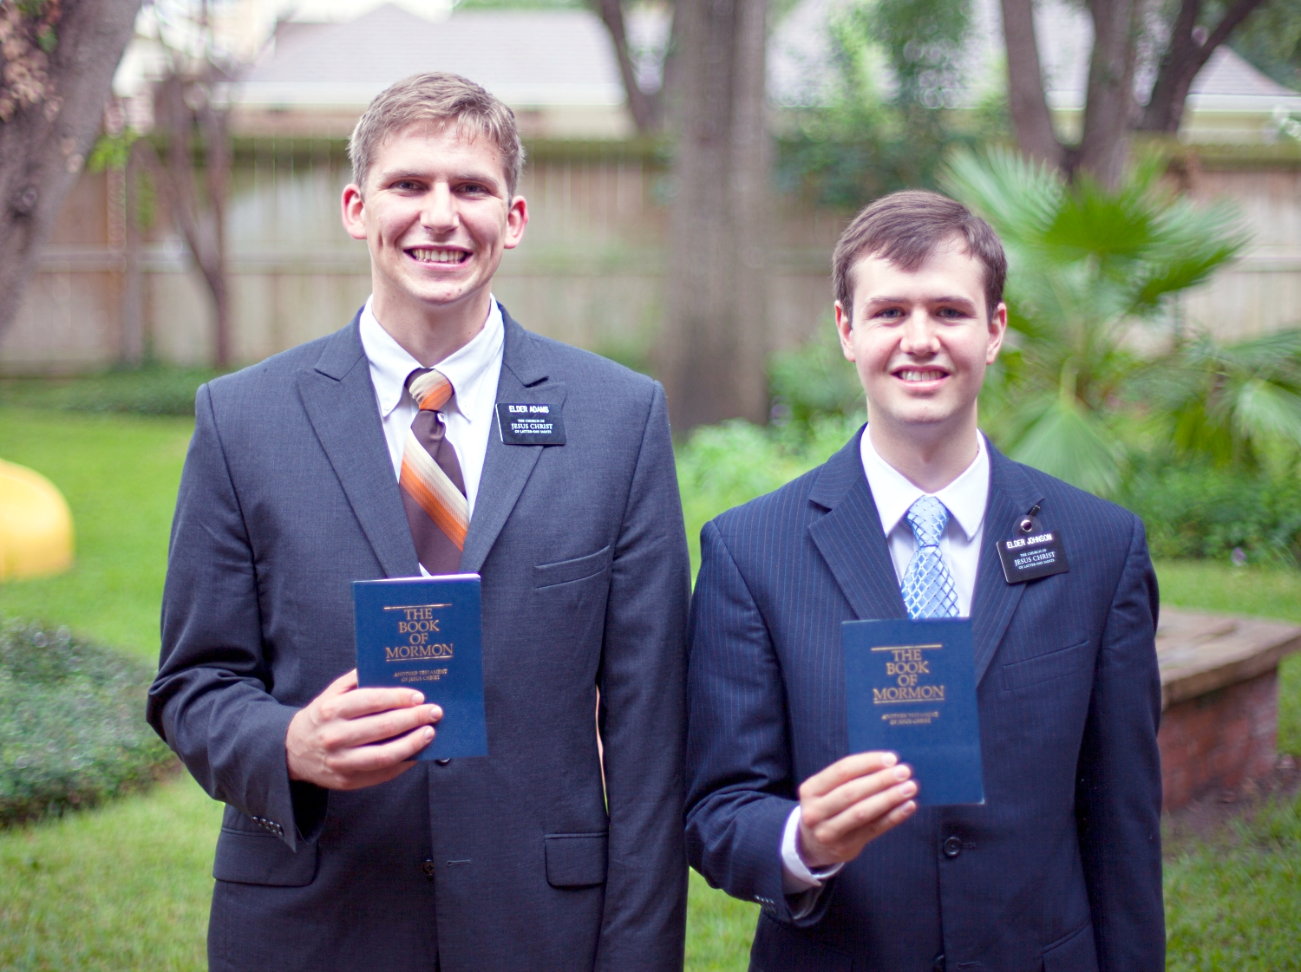

Slide 31
The original church wore no particular name.
It’s called the church, the body, the church of God, churches of Christ salute you, Christ’s body… the bride of Christ. The members of the church were simply called Christians.
Acts 11:26 - 26 and when he had found him, he brought him to Antioch. And for an entire year they met with the church and taught considerable numbers; and the disciples were first called Christians in Antioch.
Acts 26:28- 28 Agrippa replied to Paul, "In a short time you will persuade me to become a Christian."
1 Peter 4:16 - 16 but if anyone suffers as a Christian, he is not to be ashamed, but is to glorify God in this name.

Slide 32
Heb 12:23- 23 to the general assembly and church of the firstborn who are enrolled in heaven…

