Slide 1
IF
God is for us who can be against us?

Slide 2
Romans 8:1-11 -
“Therefore, there is now no condemnation for those who are in Christ Jesus,² because through Christ Jesus the law of the Spirit who gives life has set you free from the law of sin and death. ³ For what the law was powerless to do because it was weakened by the flesh, God did by sending his own Son in the likeness of sinful flesh to be a sin offering. And so he condemned sin in the flesh,⁴ in order that the righteous requirement of the law might be fully met in us, who do not live according to the flesh but according to the Spirit.
⁵ Those who live according to the flesh have their minds set on what the flesh desires; but those who live in accordance with the Spirit have their minds set on what the Spirit desires. ⁶ The mind governed by the flesh is death, but the mind governed by the Spirit is life and peace. ⁷ The mind governed by the flesh is hostile to God; it does not submit to God’s law, nor can it do so. ⁸ Those who are in the realm of the flesh cannot please God.
⁹ You, however, are not in the realm of the flesh but are in the realm of the Spirit, if indeed the Spirit of God lives in you. And if anyone does not have the Spirit of Christ, they do not belong to Christ. ¹⁰ But if Christ is in you, then even though your body is subject to death because of sin, the Spirit gives life because of righteousness. ¹¹ And if the Spirit of him who raised Jesus from the dead is living in you, he who raised Christ from the dead will also give life to your mortal bodies because of his Spirit who lives in you.

Slide 3
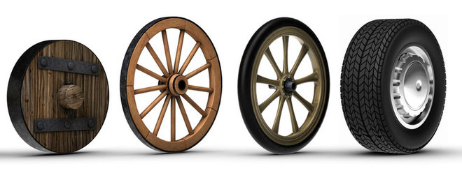
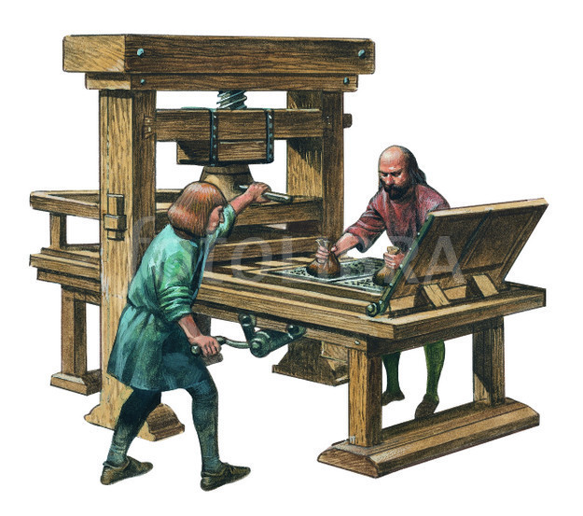


Slide 4


Slide 5
1066 - Edward the Confessor died
Harold, Earl of Wessex, immediately took the throne for himself and held it for four weeks.
Until William, Duke of Normandy invaded.
Battle of Hastings
When the English and Norman armies met at Hastings, their forces were evenly matched. But it was William’s invention of the stirrup that turned the tide of battle in his favor.
William began the battle with a barrage from his archers and then charged with his infantry.
When the English defenses held firm, William unveiled his secret weapon—mounted knights whose feet were secured to their horses with stirrups.
Duke William of Normandy became William I, king of England, better known today as William the Conqueror.

Slide 6
“For our struggle is not against flesh and blood, but against the rulers, against the authorities, against the powers of this dark world and against the spiritual forces of evil in the heavenly realms”
(Ephesians 6:12).

Slide 7
“more than conquerors” in Christ Jesus (Romans 8:37)

Slide 8
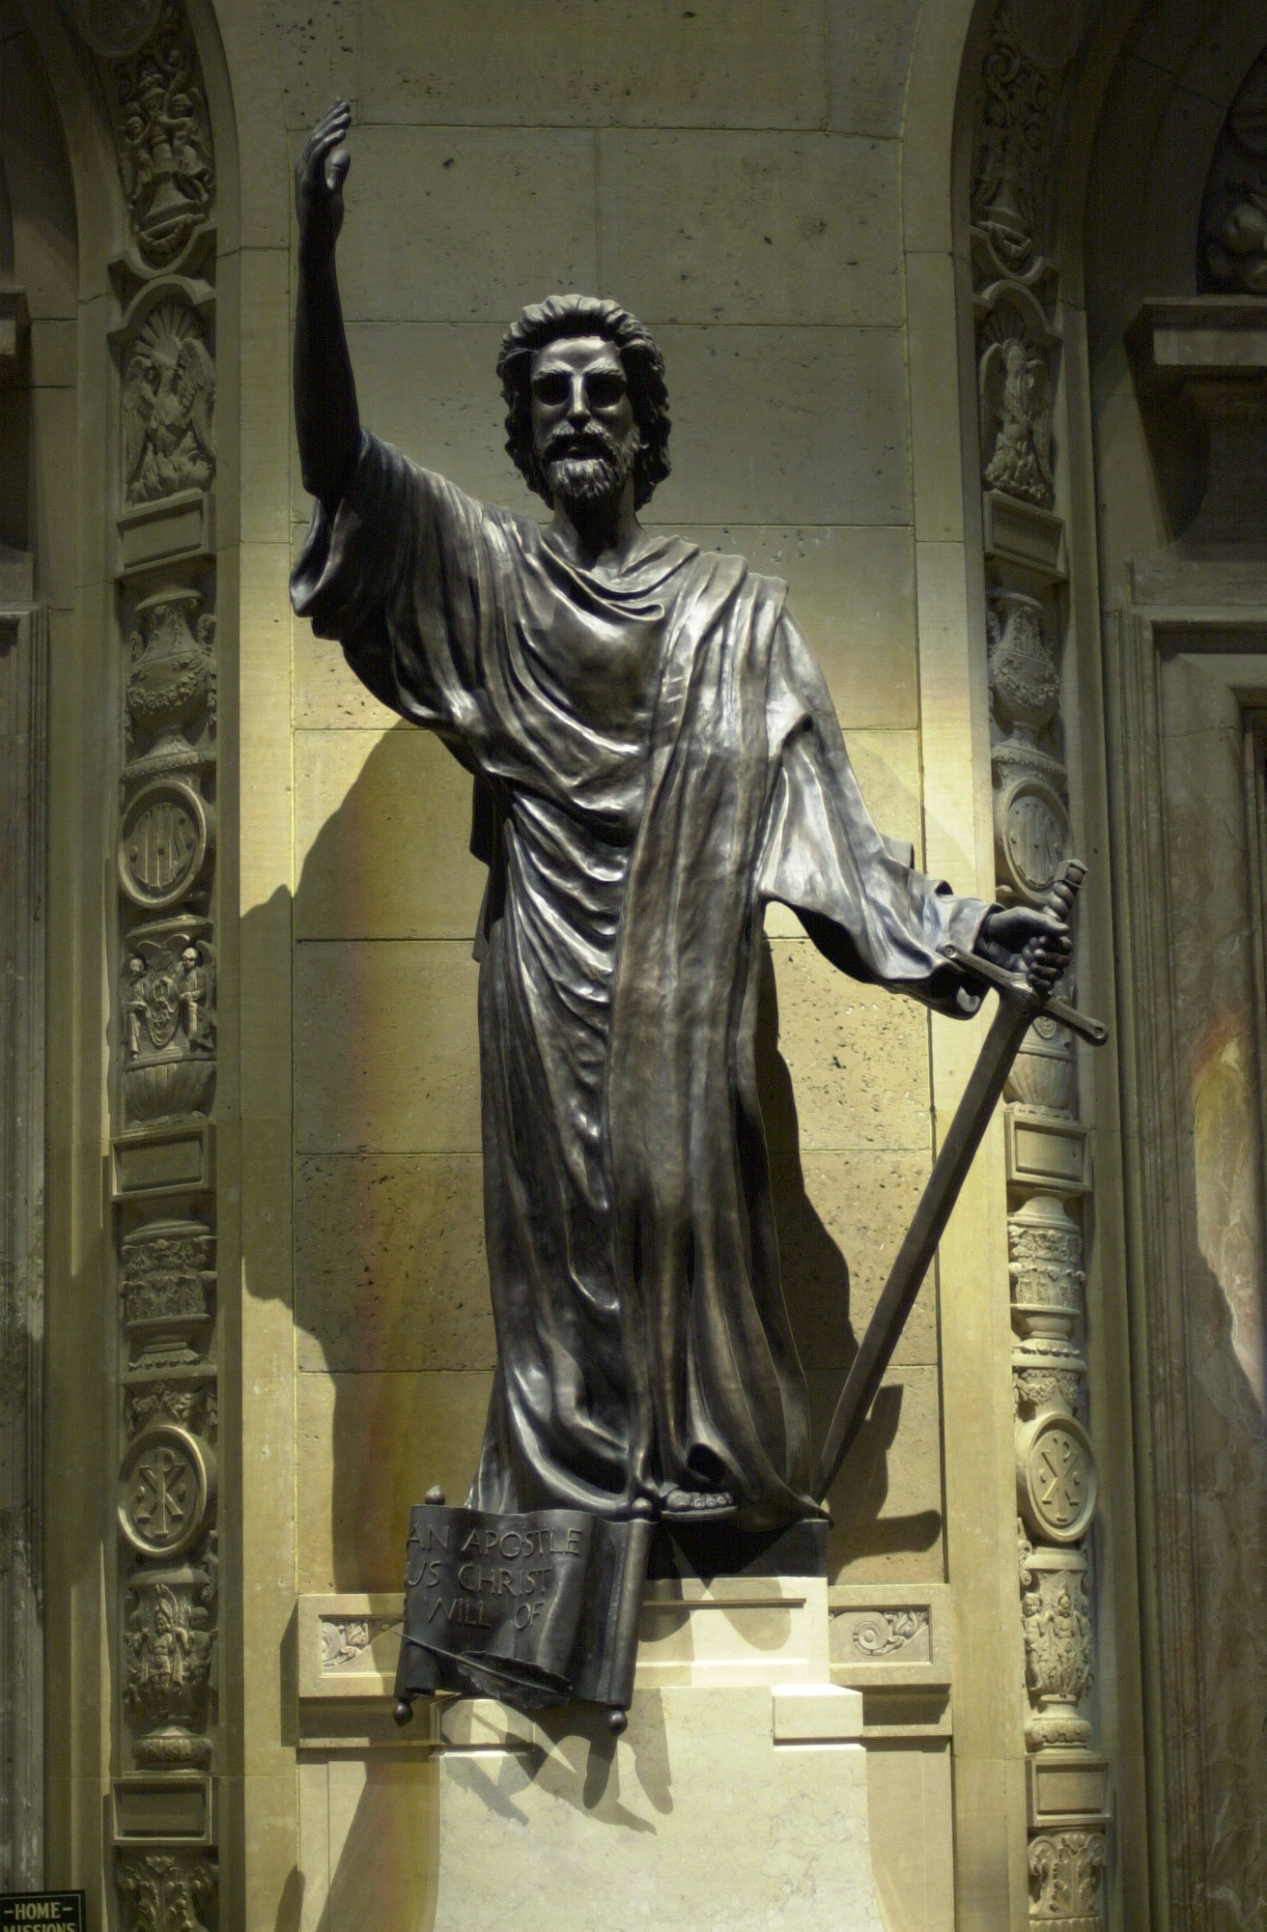
"Therefore, there is now no condemnation for those who are in Christ Jesus."

Slide 9
2 Corinthians 11:23-28 - Are they servants of Christ?—I speak as if insane—I more so; in far more labors, in far more imprisonments, beaten times without number, often in danger of death. 24 Five times I received from the Jews thirty-nine lashes. 25 Three times I was beaten with rods, once I was stoned, three times I was shipwrecked, a night and a day I have spent in the deep. 26 I have been on frequent journeys, in dangers from rivers, dangers from robbers, dangers from my countrymen, dangers from the Gentiles, dangers in the city, dangers in the wilderness, dangers on the sea, dangers among false brethren; 27 I have been in labor and hardship, through many sleepless nights, in hunger and thirst, often without food, in cold and exposure. 28 Apart from such external things, there is the daily pressure on me of concern for all the churches.

Slide 10
Romans 7:14-15 (NASB)
¹⁴ For we know that the Law is spiritual, but I am of flesh, sold into bondage to sin.
¹⁵ For what I am doing, I do not understand; for I am not practicing what I would like to do, but I am doing the very thing I hate.
Romans 7:18-19 (NASB)
¹⁸ For I know that nothing good dwells in me, that is, in my flesh; for the willing is present in me, but the doing of the good is not.
¹⁹ For the good that I want, I do not do, but I practice the very evil that I do not want.
Romans 7:19- For the good that I would I do not: but the evil which I would not, that I do. KJV

Slide 11
Romans 7:22-24. - 22 I love God's law with all my heart. 23 But there is another power within me that is at war with my mind. This power makes me a slave to the sin that is still within me. 24 Oh, what a miserable person I am! Who will free me from this life that is dominated by sin and death? Holy Bible, New Living Translation

Slide 12
Rom 7:24-8:2
24 Wretched man that I am! Who will set me free from the body of this death? 25 Thanks be to God through Jesus Christ our Lord! So then, on the one hand I myself with my mind am serving the law of God, but on the other, with my flesh the law of sin.
Deliverance from Bondage
8:1 Therefore there is now no condemnation for those who are in Christ Jesus. 2 For the law of the Spirit of life in Christ Jesus has set you free from the law of sin and of death.
NASU

Slide 13
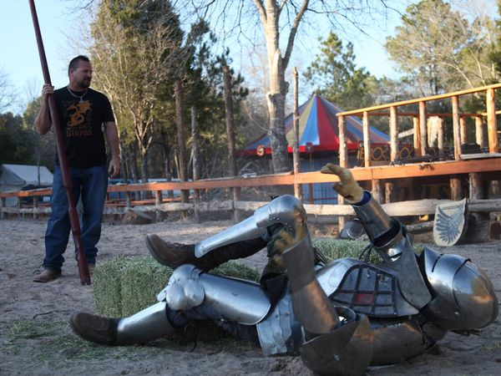
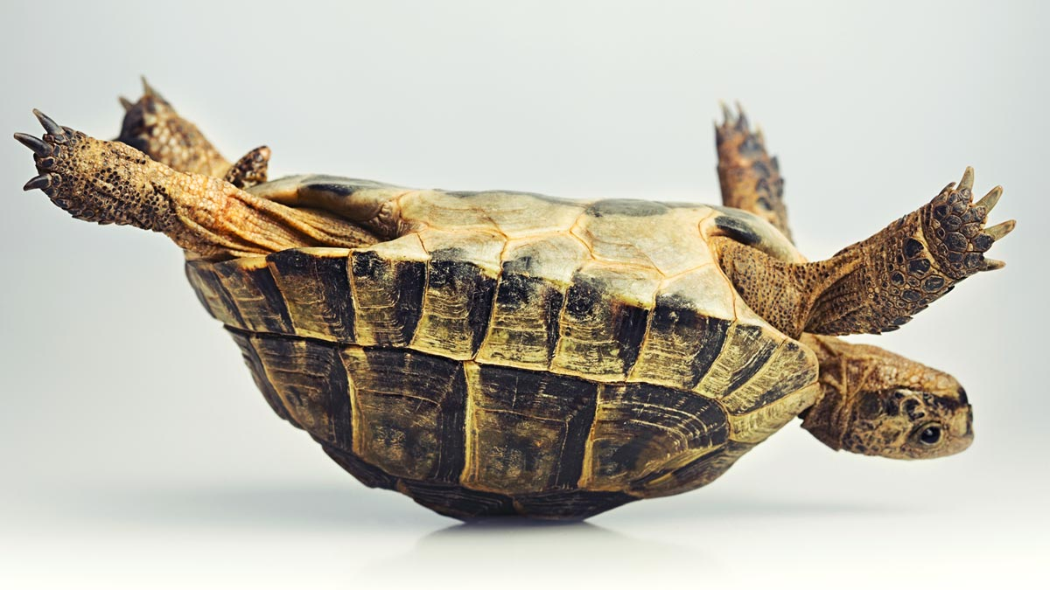

Slide 14
"There is no condemnation for those who are in Christ Jesus."

Slide 15

"There is no condemnation for those who are in Christ Jesus."

Slide 16

Do you remember what the word "SATAN" means in Hebrew, Aramaic, and in Greek?

Slide 17
Proverbs 23:7 - for as he thinks within himself, so he is.

Slide 18
"Therefore, there is now no condemnation for those who are in Christ Jesus."
Do you believe it?

Slide 19
Romans 8:35-39 - 35 Can anything ever separate us from Christ's love? Does it mean he no longer loves us if we have trouble or calamity, or are persecuted, or hungry, or destitute, or in danger, or threatened with death? 36 (As the Scriptures say, "For your sake we are killed every day; we are being slaughtered like sheep.") 37 No, despite all these things, overwhelming victory is ours through Christ, who loved us. 38 And I am convinced that nothing can ever separate us from God's love. Neither death nor life, neither angels nor demons, neither our fears for today nor our worries about tomorrow—not even the powers of hell can separate us from God's love. 39 No power in the sky above or in the earth below—indeed, nothing in all creation will ever be able to separate us from the love of God that is revealed in Christ Jesus our Lord. Holy Bible, New Living Translation

Slide 20
The gift of God is eternal life "in Christ Jesus."

