Slide 1
The Law of the Lord is Perfect Converting the Soul Psalms 19:7-14
Psalm 19:7 - "The law of the Lord is perfect converting the soul.“
"I’ve got some good news for you: someone has just paid a $25,000 speeding fine on your behalf."

Slide 2
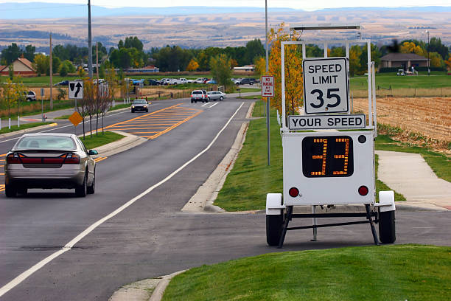
15

Slide 3
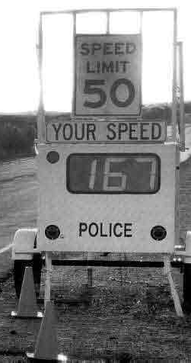
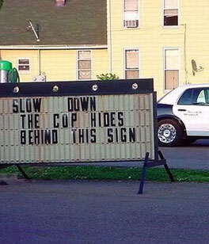

Slide 4
TEN CLEAR WARNING SIGNS

Slide 5
"Jesus Christ died on the cross for your sins," it will be foolishness and offensive to you.
Foolishness because it won’t make sense. The Bible says that: "The preaching of the cross is to them that perish foolishness" (1 Corinthians 1:18).
And offensive because I’m insinuating this person is a sinner when he doesn’t think he is.

Slide 6
"convinced of the law as a transgressor" (James 2:9)

Slide 7
"the power of God unto salvation" (Rom. 1:16).

Slide 8
Romans 3:19 – "Now we know that whatsoever things the law says, it says to them who are under the law that every mouth may be stopped and all the world may become guilty before God."

Slide 9
“There’s plenty of people worse than me. I’m not a bad person. Really.”
Romans 3: 20 - 20 because by the works of the Law no flesh will be justified in His sight; for through the Law comes the knowledge of sin.

Slide 10
God’s law tells us what sin is.
1 John 3:4 -"Sin is transgression of the law."
Romans 7: 7 - "What shall we say then? Is the law sin? God forbid! No, I had not known sin but by the law."
Paul says, "I didn’t know what sin was until the law told me." Defined it for me. In Galatians 3:24 - So then, the law was our guardian until Christ came, in order that we might be justified by faith. ESV

Slide 11
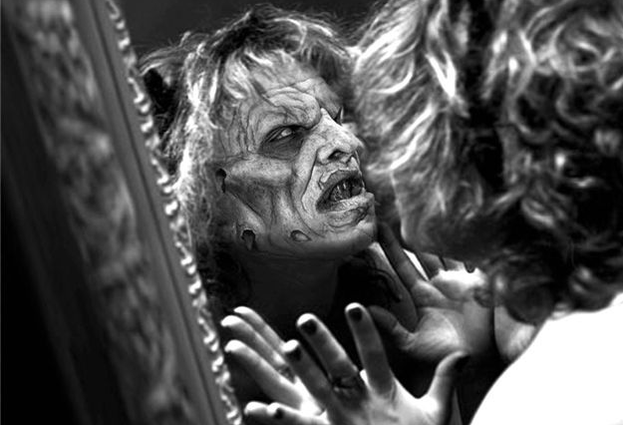

Slide 12
"life enhancement".
"Jesus Christ will give you peace, joy, love, fulfillment, and lasting happiness."

Slide 13
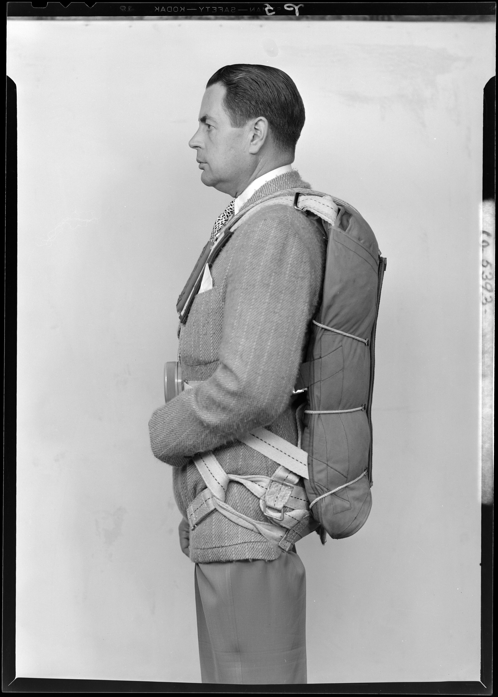

Slide 17
It says, "Put on the Lord Jesus Christ. He’ll give you love, joy, peace, fulfillment, and lasting happiness." In other words, "Jesus will improve your flight."

Slide 18
Part of the preaching of the message that Jesus improves the flight is warning the passengers they’re going have to jump out of the plane.
Hebrews 9:27 (NASB) ²⁷ And inasmuch as it is appointed for men to die once and after this comes judgment,
"commands all men everywhere to repent" (Acts 17:30).
Why? "Because He has appointed a day, in which He will judge the world in righteousness" (vs. 31).

Slide 19
You see, the issue isn’t one of happiness, but one of righteousness. Without the righteousness of Christ, we’ll perish on the day of wrath.
Proverbs 11:4 - Riches do not profit in the day of wrath, but righteousness delivers from death.

Slide 21
"joy and peace in believing" (Rom. 15:13)

Slide 22
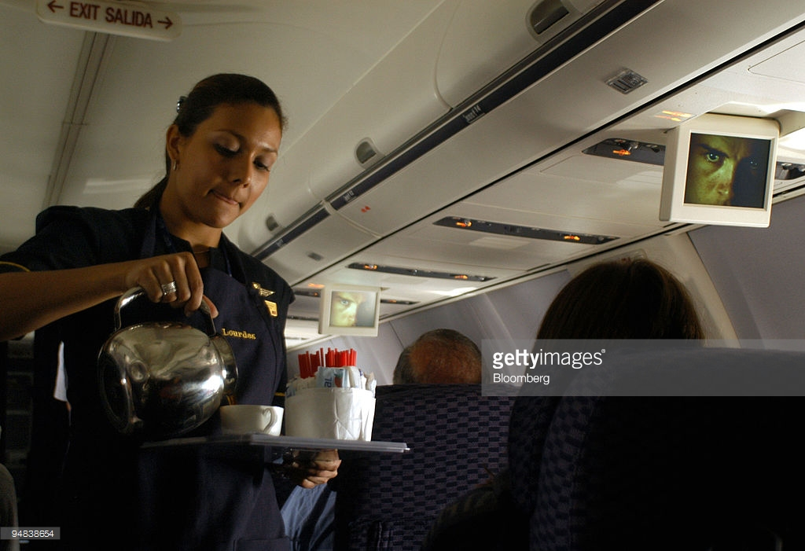

Slide 23
John 10:10 (NASB) ¹⁰ "The thief comes only to steal and kill and destroy; I came that they may have life, and have it abundantly.

Slide 24
. Isaiah 59:1-2 (NASB) ¹ Behold, the LORD'S hand is not so short That it cannot save; Nor is His ear so dull That it cannot hear. ² But your iniquities have made a separation between you and your God, And your sins have hidden His face from you so that He does not hear.

Slide 25
2 Corinthians 5:10 (NASB) 10 For we must all appear before the judgment seat of Christ, so that each one may be recompensed for his deeds in the body, according to what he has done, whether good or bad.

Slide 26
Acts 2:38 (NASB) - 38 Peter said to them, "Repent, and each of you be baptized in the name of Jesus Christ for the forgiveness of your sins; and you will receive the gift of the Holy Spirit.
Psalms 51:4 -"Against you, and you only, have I sinned, and done this evil in your sight".
"How can I do this thing and sin against God?" (Gen. 39:9)
The prodigal son said, "I’ve sinned against heaven" (Luke 15:21)
Paul preached "repentance toward God" (Acts 20:21)

Slide 27
A.B. Earl said, "I have found by long experience that the severest threatenings of the law of God have a prominent place in leading men to Christ. They must see themselves lost before they will cry for mercy; they’ll not escape danger until they see it."

